Slide 1
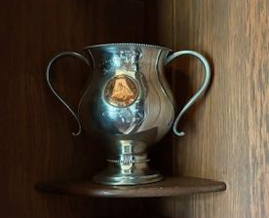
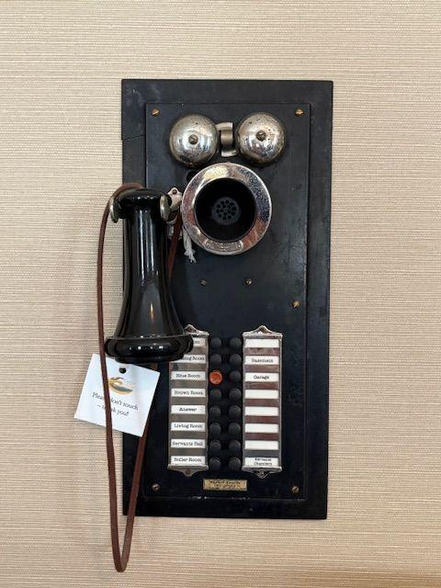
Trophy
 | Given to someone who wins or does something well
Intercom
 | A two-way communication device; like a phone

Slide 2
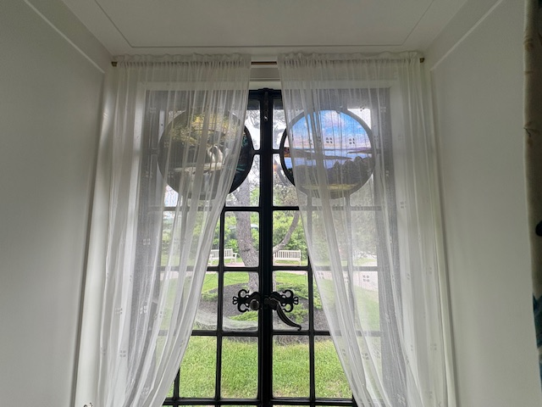
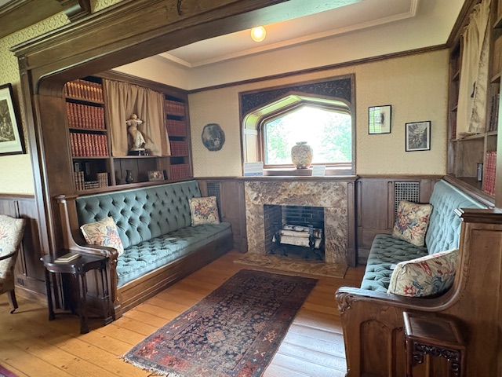
Roundel
 | Round pieces of glass used to decorate inside.
Inglenook
 | A small space by a fireplace, often with a bench.

Slide 3
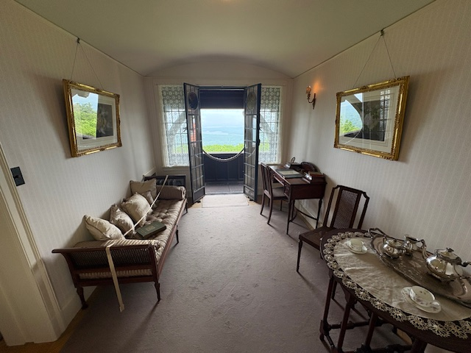
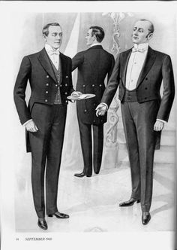
Boudoir
 | A woman’s dressing room, bedroom, or sitting room.
Butler
 | The chief male servant of a household in charge of other employees.

Slide 4
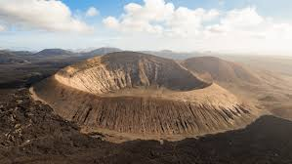
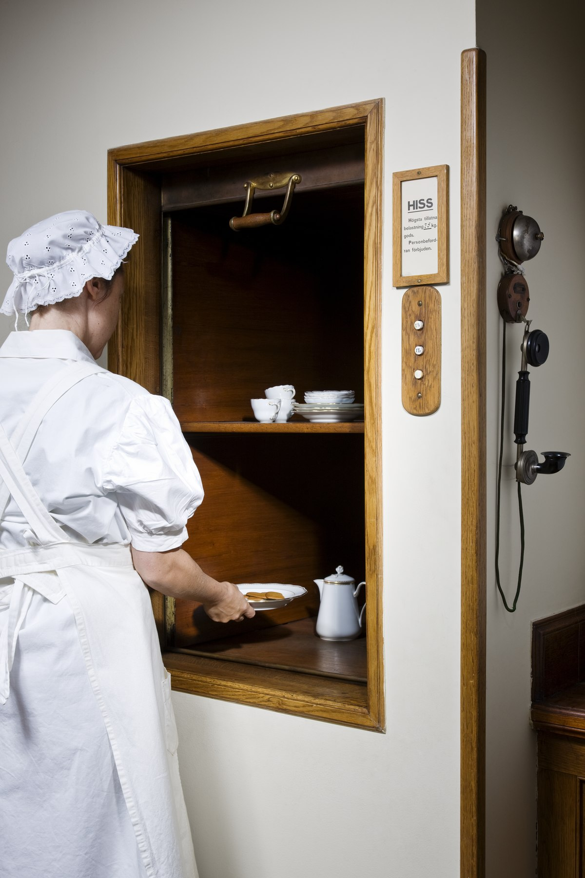
Caldera
 | A giant bowl-shaped hole from where a volcano erupts and then collapses.
Dumbwaiter
 | A small elevator used to move food and dishes from one floor to another.

Slide 5
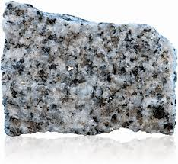
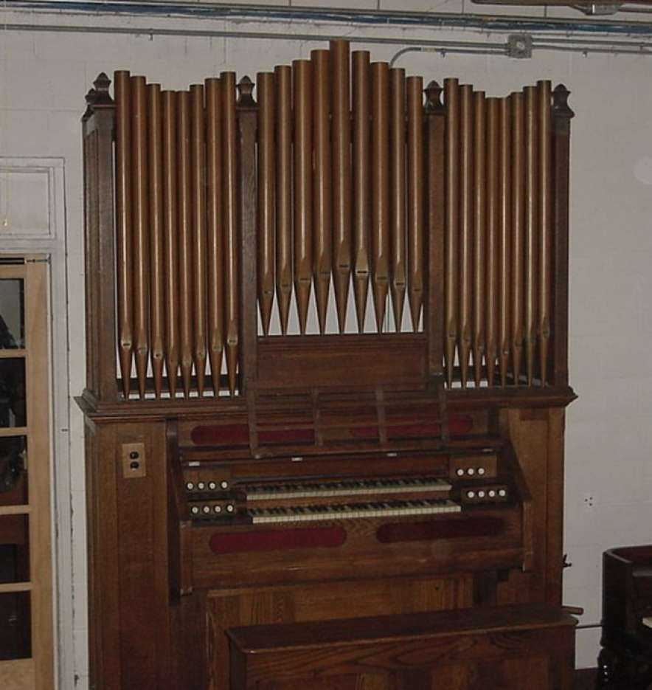
Granite
 | Very hard, igneous rock, often used for building or monuments.
Organ
 | A keyboard instrument that uses air blown through pipes to make sound.

Slide 6
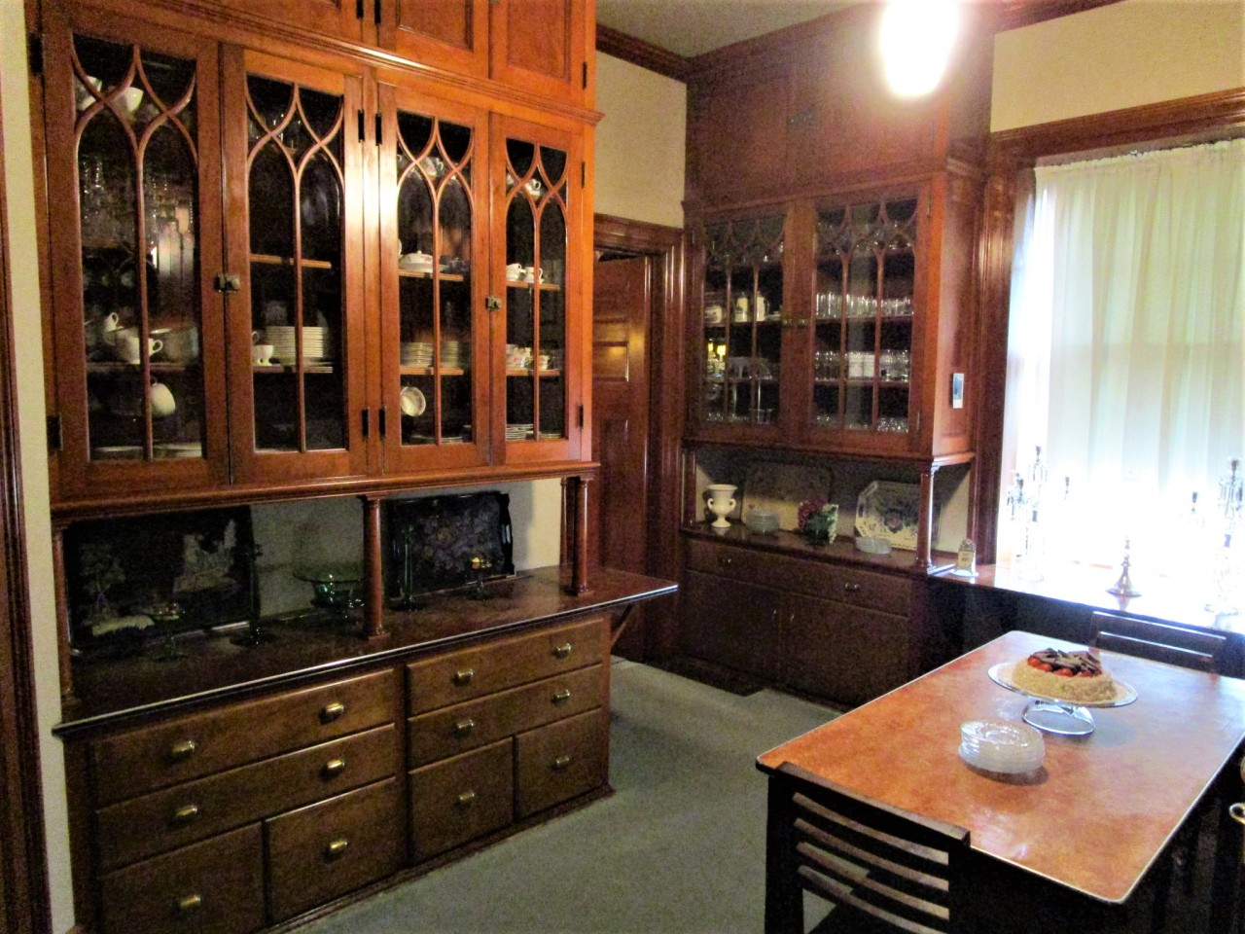
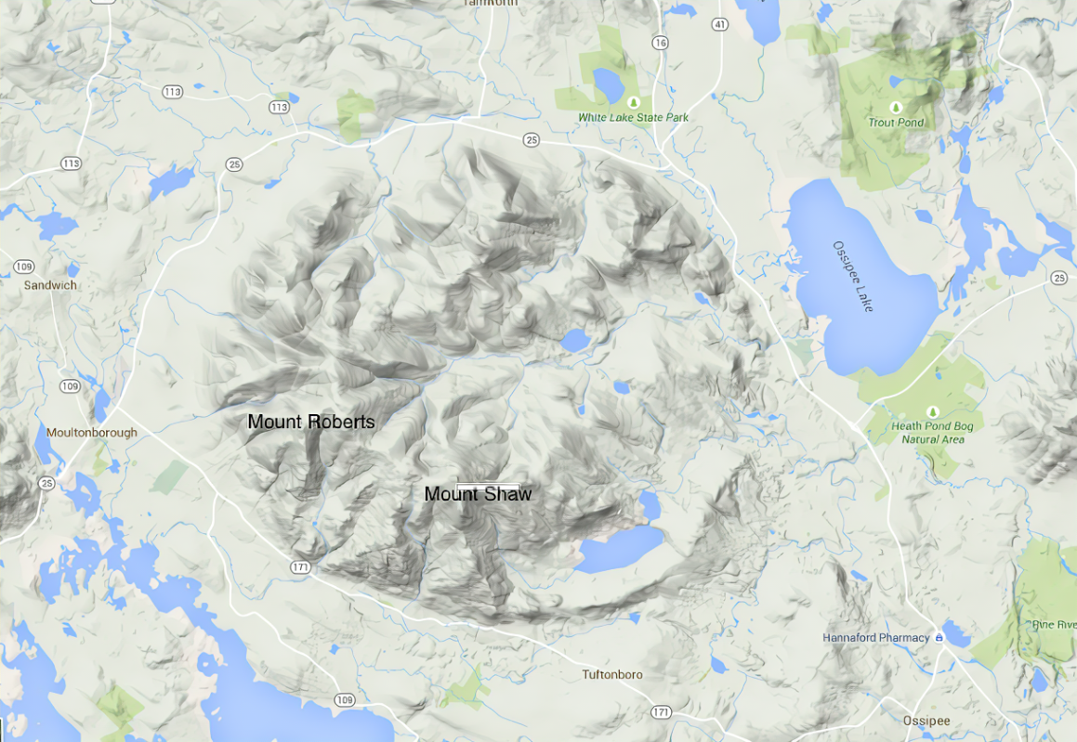
Pantry
 | A room for the preparation or storage of food.
Ring Dike
 | A circular mountain range formed by a volcano caving in on itself due to eruption.

Slide 7
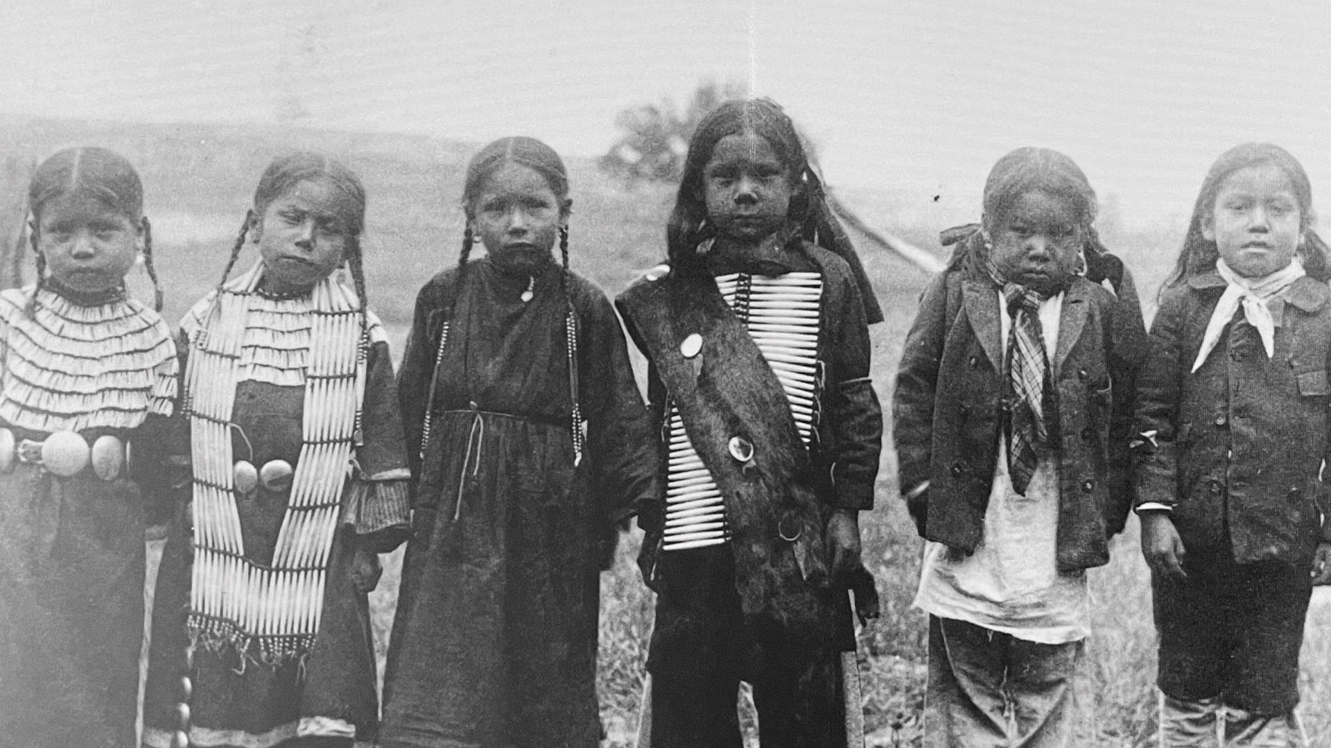
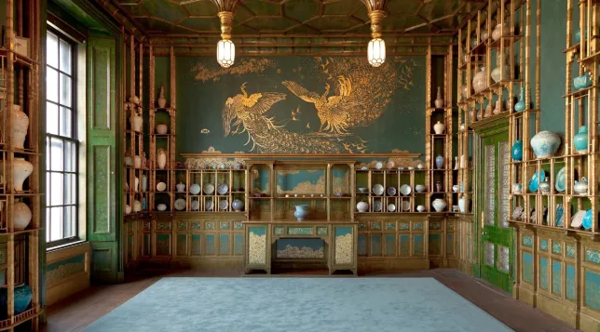
Indigenous
 | The first people to live in a particular place. In the US, this was the Native Americans.
Arts & Crafts Movement
 | A movement in the late 19th and early 20th centuries that promoted making things by hand versus industrial production.

Slide 8
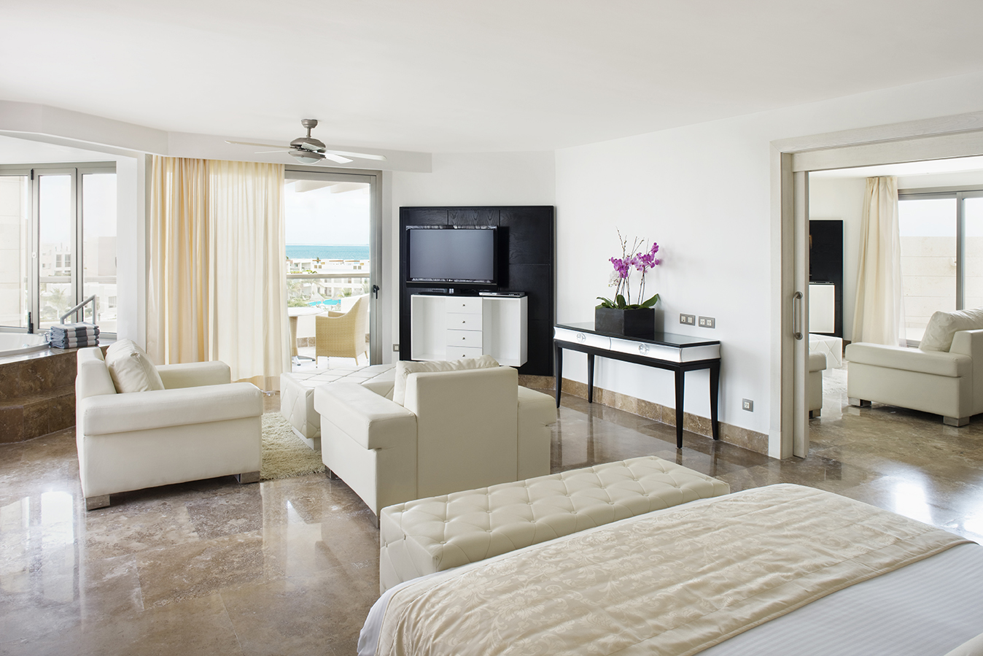
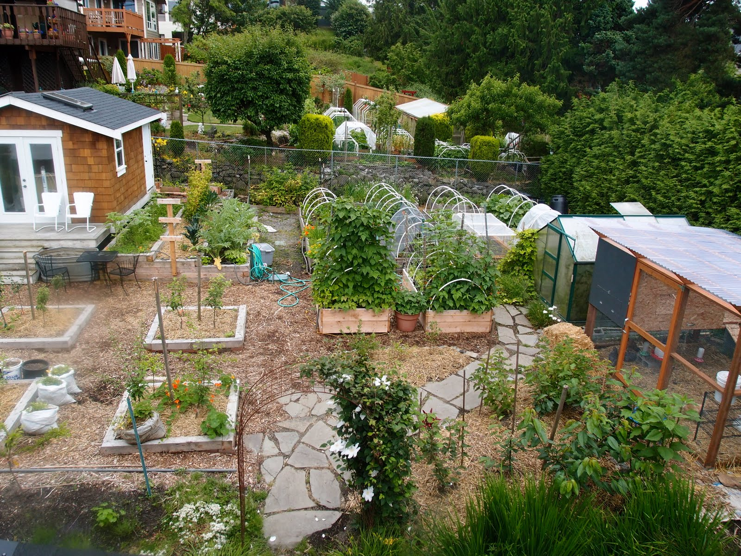
Suite
 | A group of rooms that make up one larger room (like a hotel with many spaces).
Homesteading
 | A self-sufficient life; grow food, take care of animals, make things yourself

Slide 9
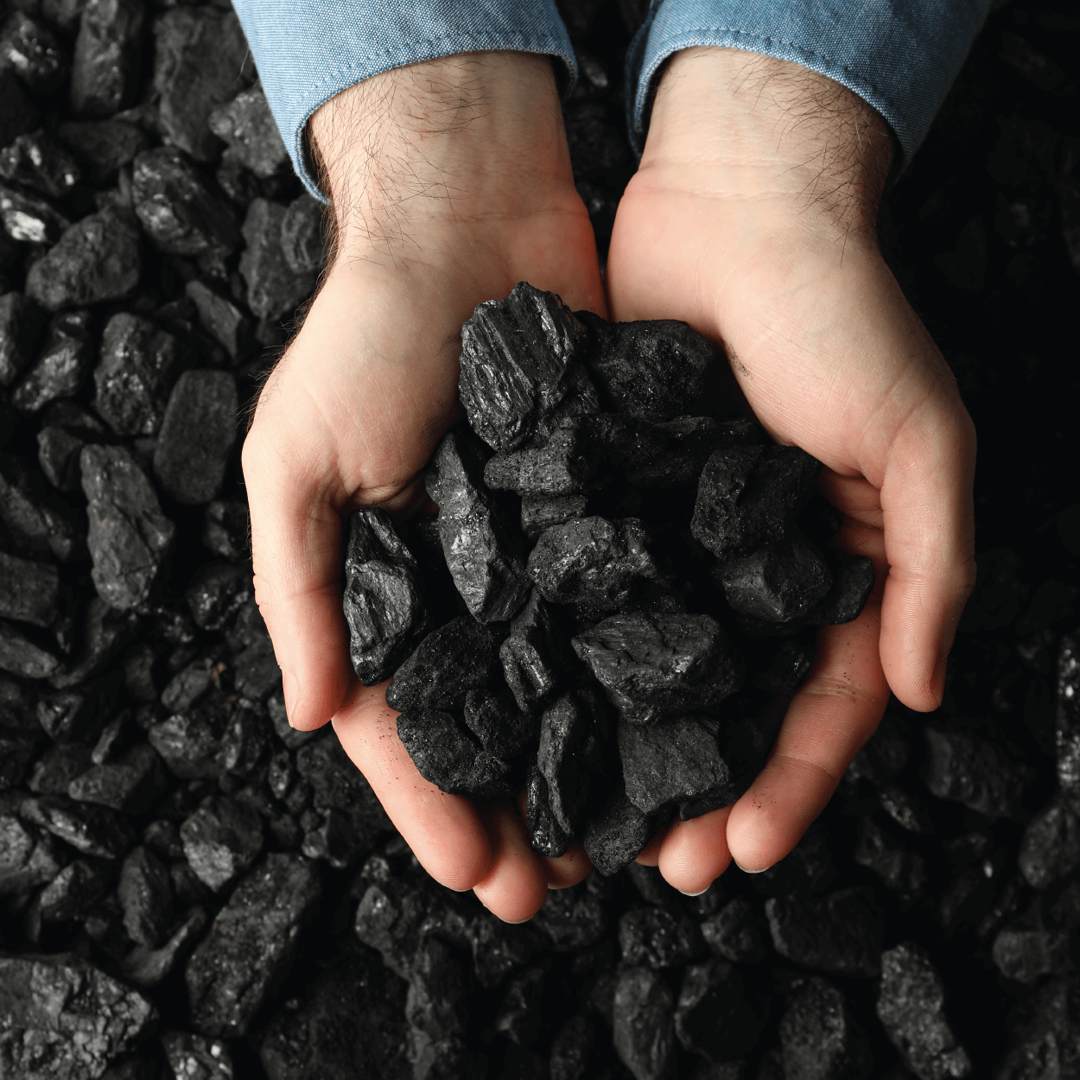
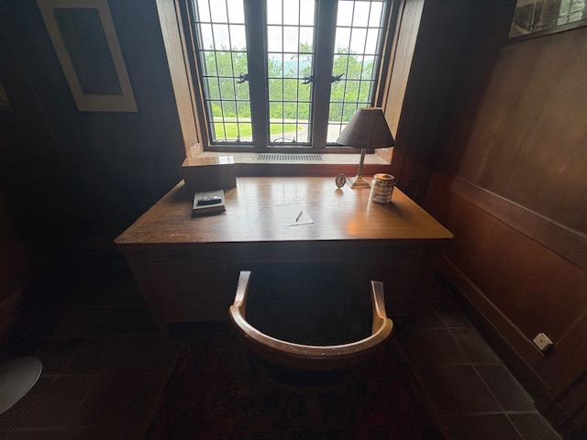
Coal
 | A black solid substance formed by the partial decomposition of vegetable matter.
Office
 | A place or room someone might go to to do work, write a letter, or make a call.

Slide 10
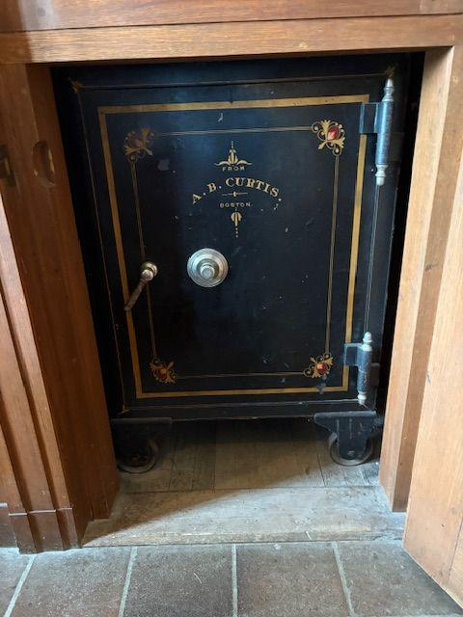
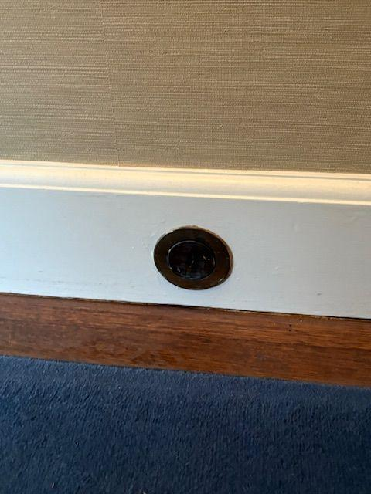
Safe
 | A strong metal box that is kept locked to keep valuable things secure.
Central Vacuum Outlet
 | Connected to a large built-in system to help clean rooms.

