Slide 1

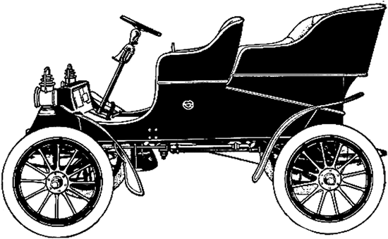
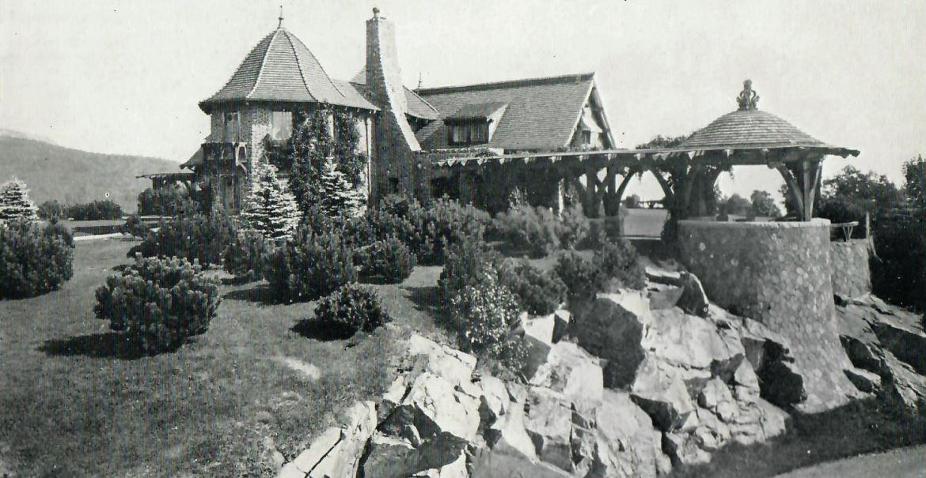
The Lucknow Mail
BREAKING NEWS!
Tom and Olive plant have invited YOU to come stay at Lucknow!
Your friends, Tom and Olive plant want you to come and spend some time with them at the Lucknow Mansion. Make sure to pack for all the different activities as well as the ever changing New England weather. Enjoy!
Notes:
Teacher Notes: Start lesson by reading The Story of Tom and Olive Plant

Slide 2
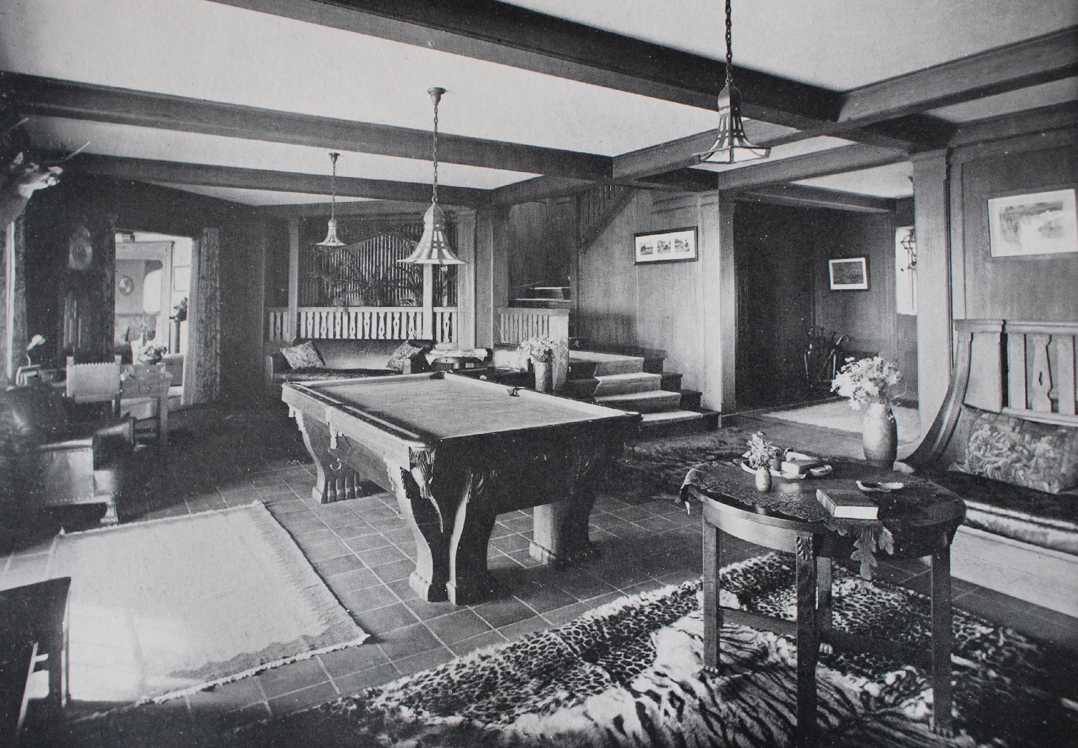
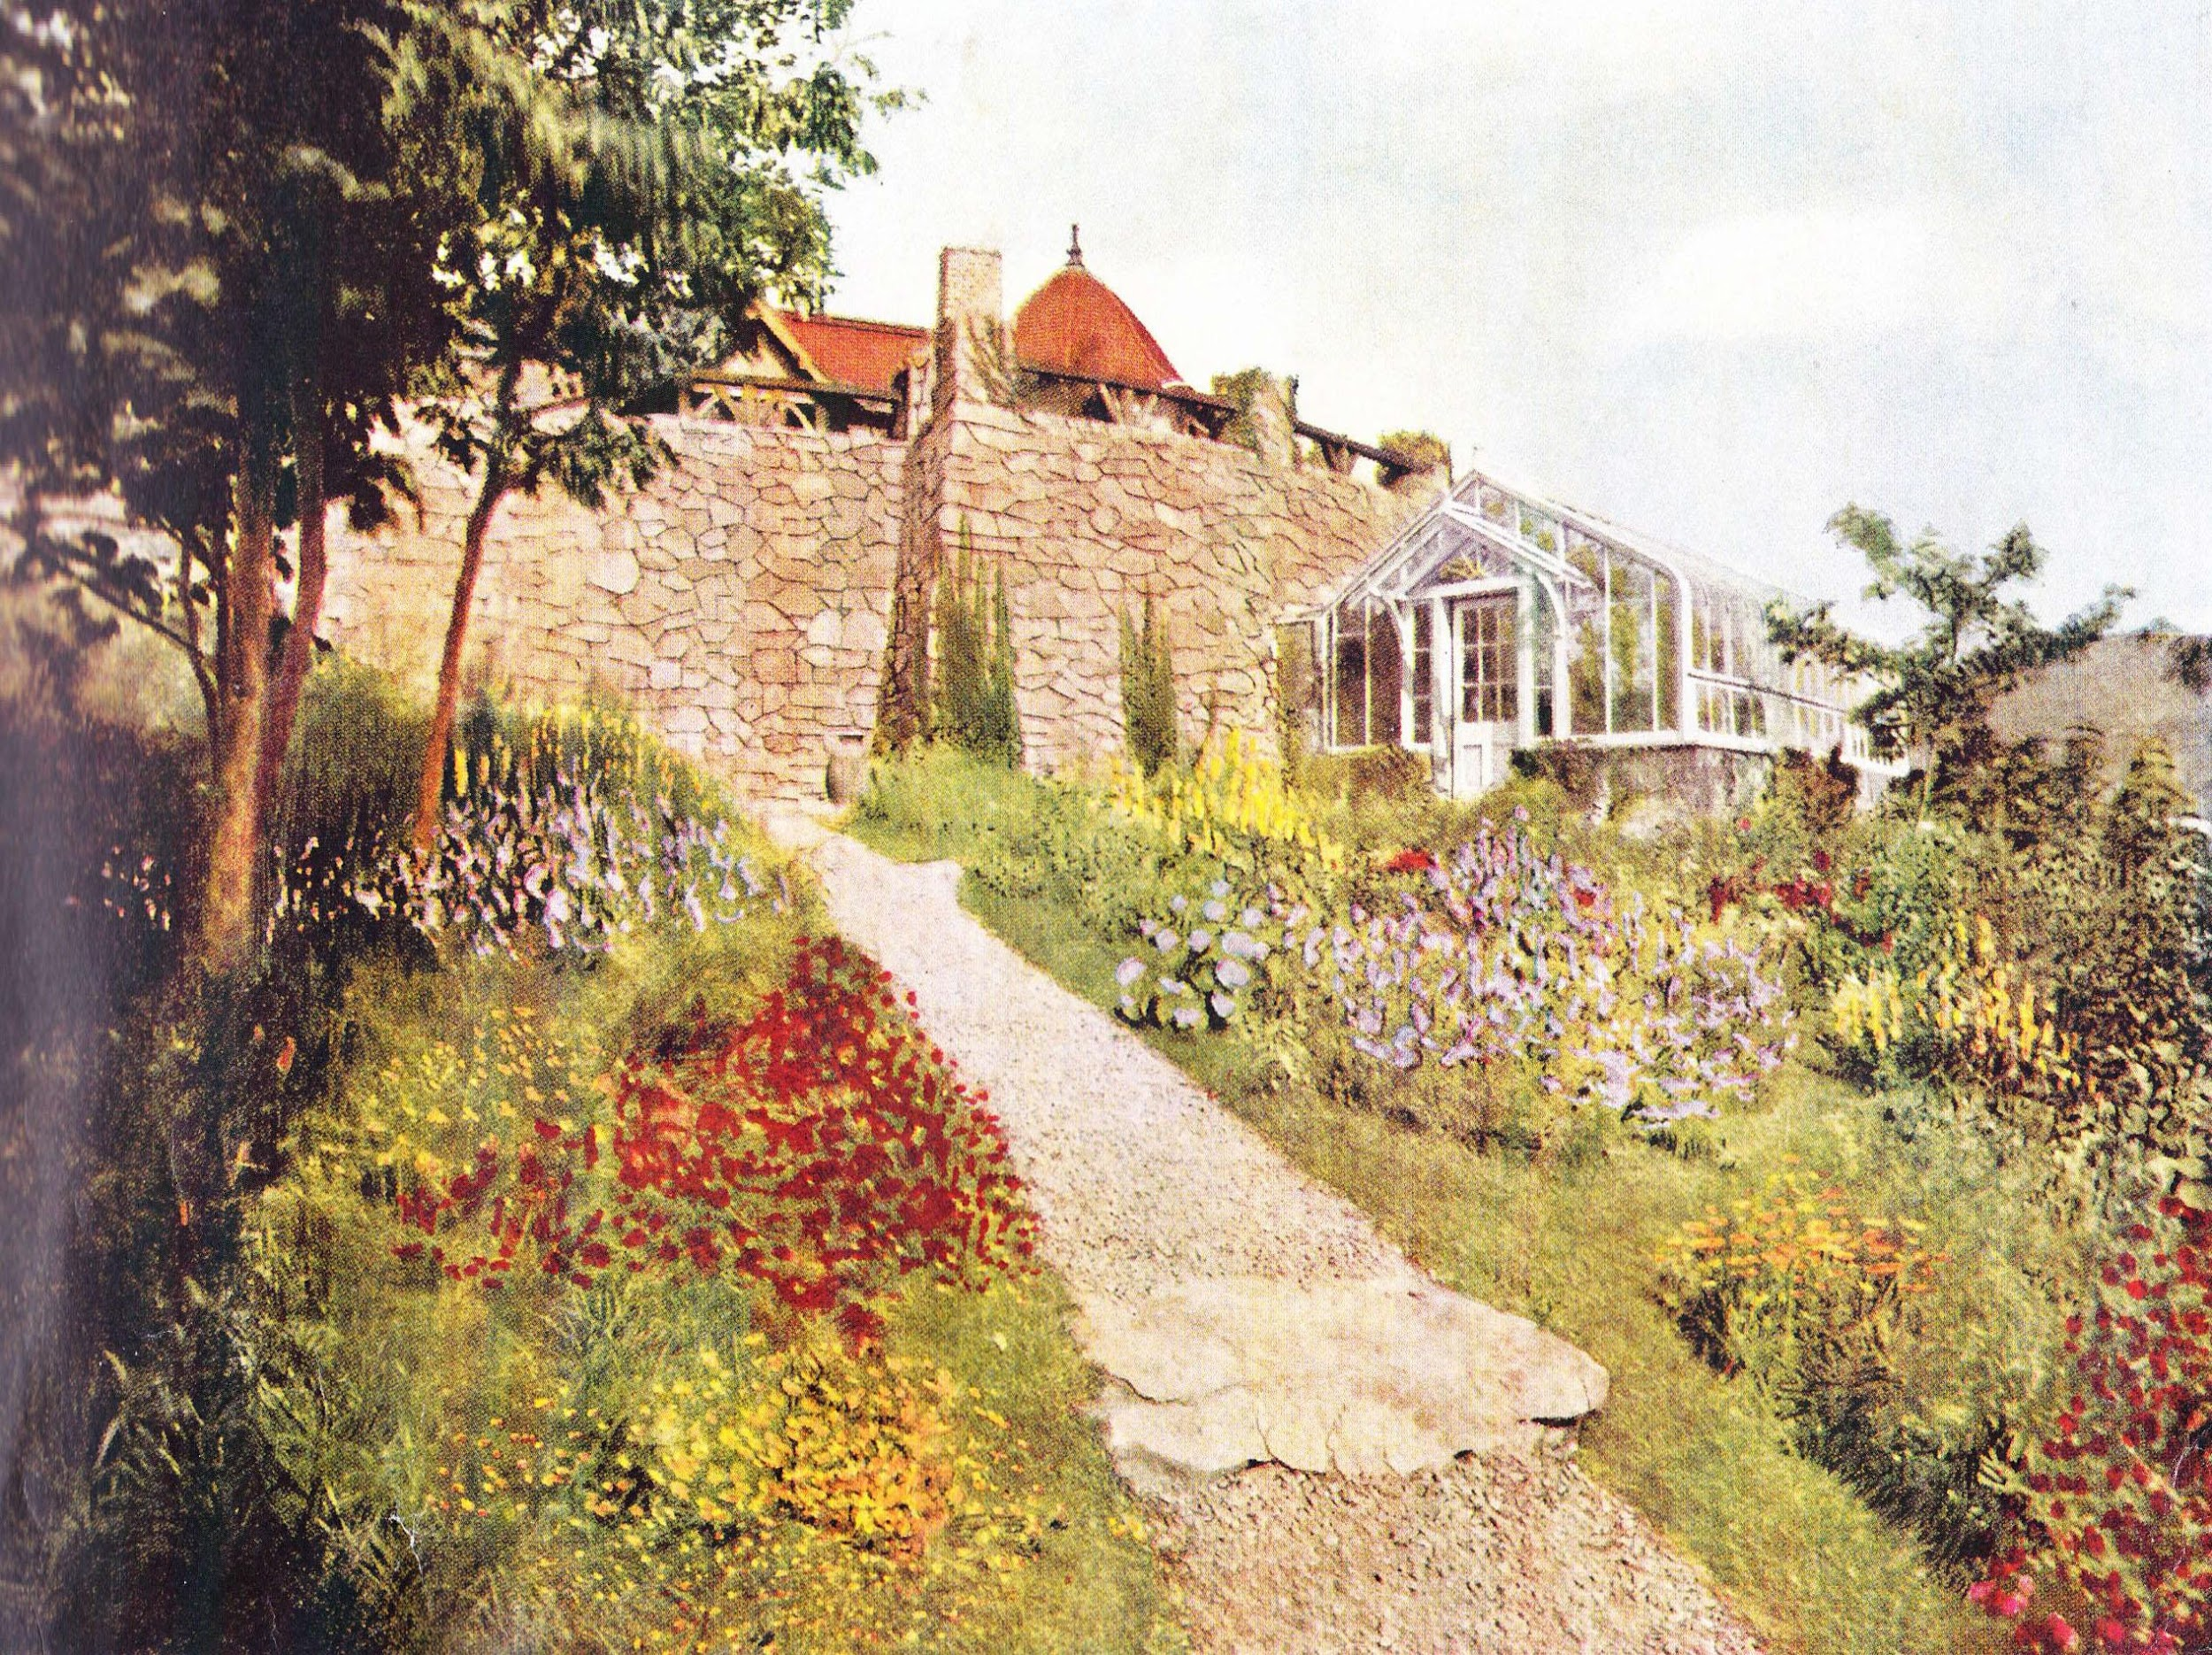
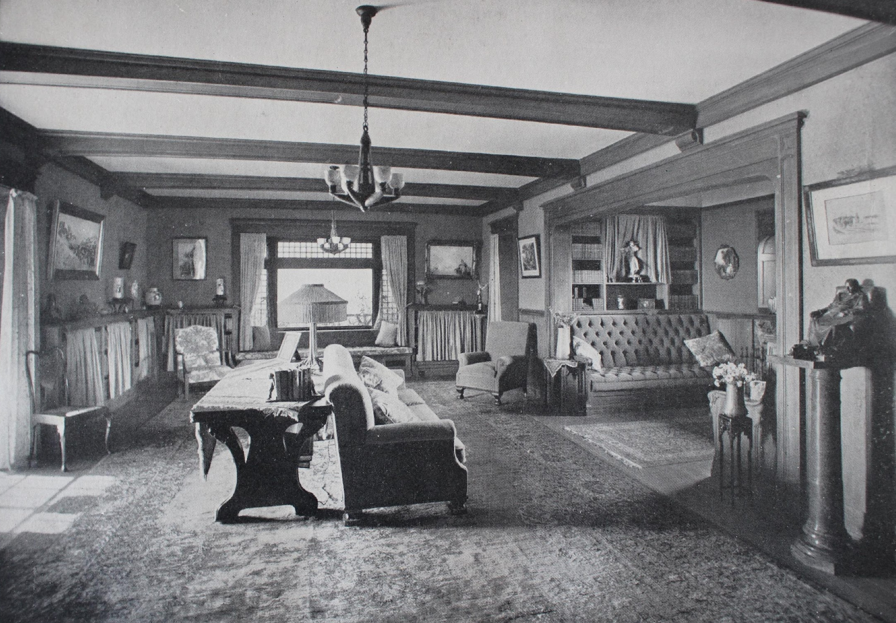
The Lucknow News
Activities at Lucknow
Playing Games
Walking in the Garden
Reading
Notes:
Teacher Notes: Introduce the different activities that students may participate in during their stay at Lucknow. Pause to reflect about the items you might need in order to participate in these activities (hats, gloves, boots, bathing suits, ice skates, a fishing pole, etc.)

Slide 3
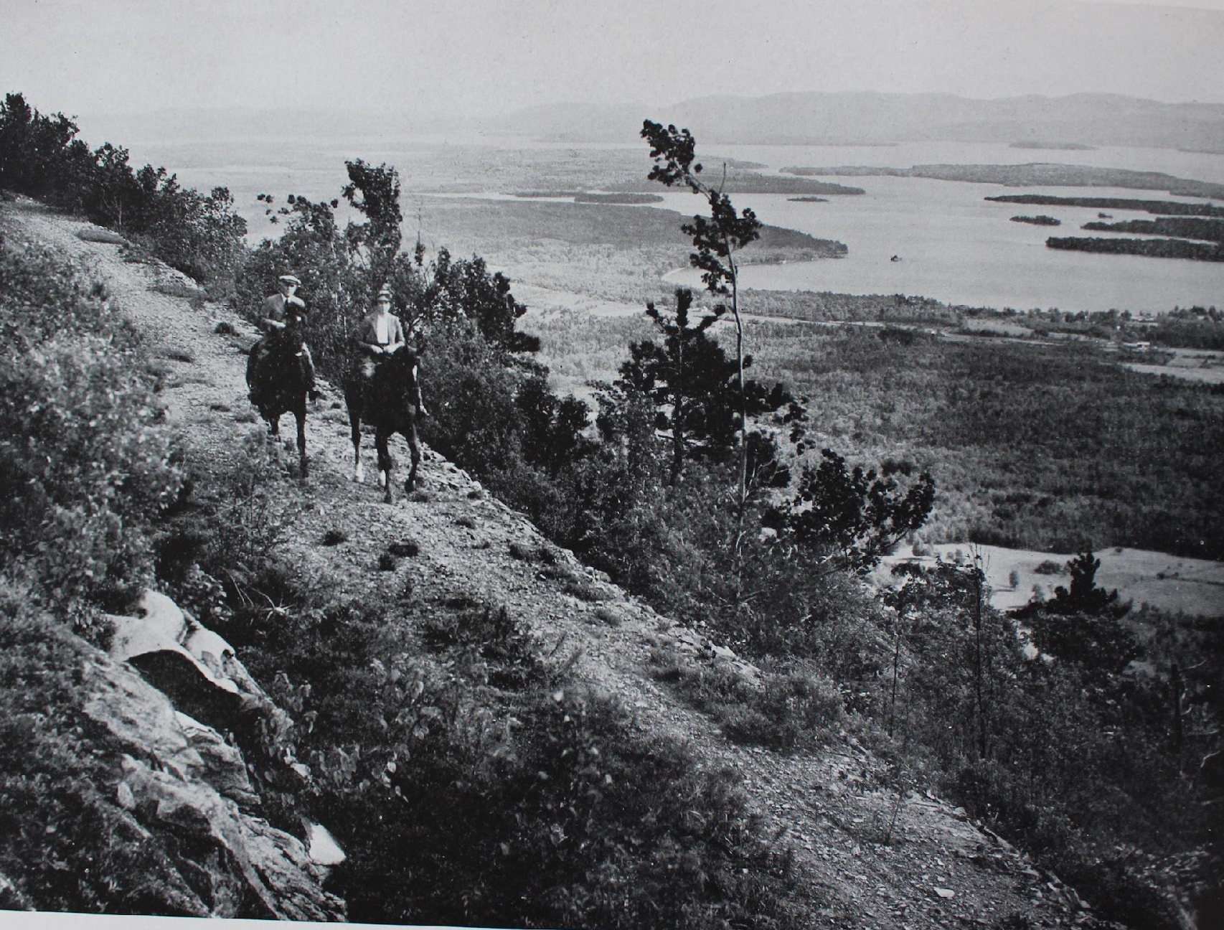
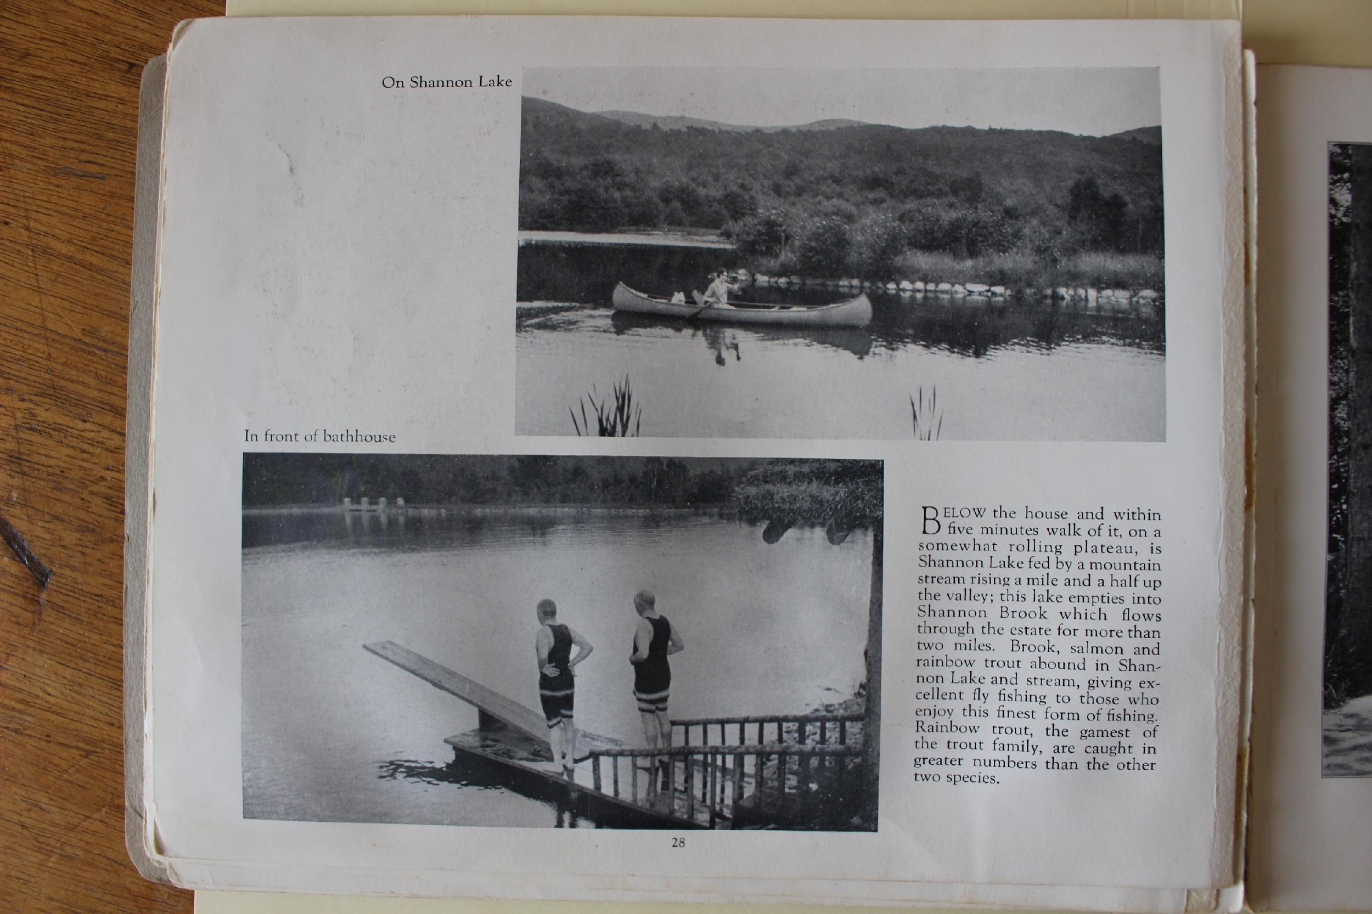
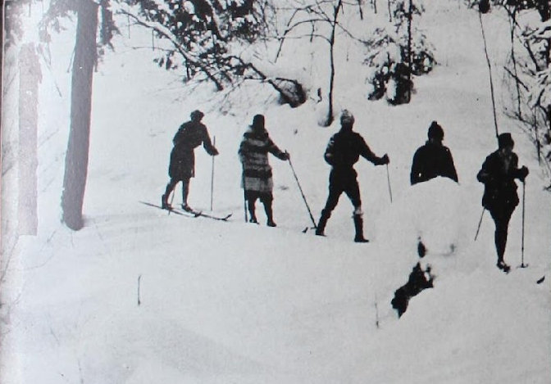
The Lucknow News
Activities at Lucknow
Horseback Riding
Canoe Rides
Cross Country Skiing

Slide 4
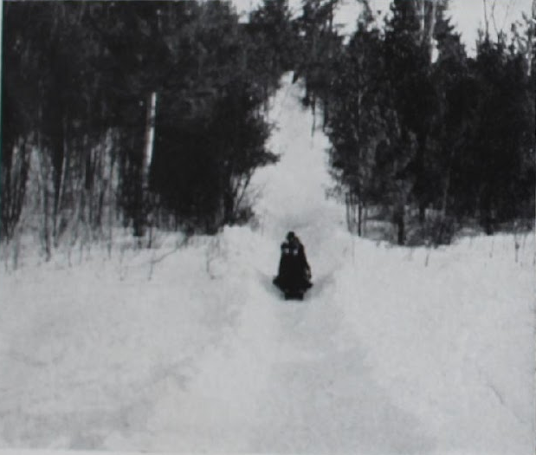
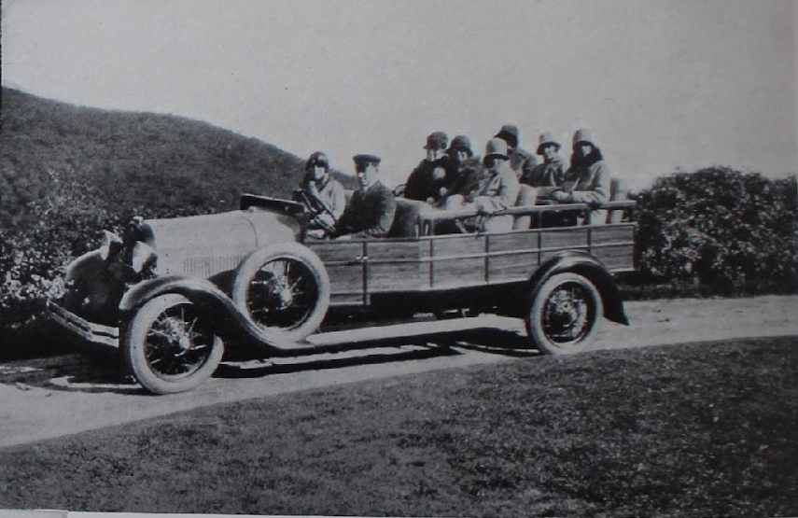
The Lucknow News
Activities at Lucknow
Swimming & Diving
Sledding
Car Rides with Friends

Slide 5
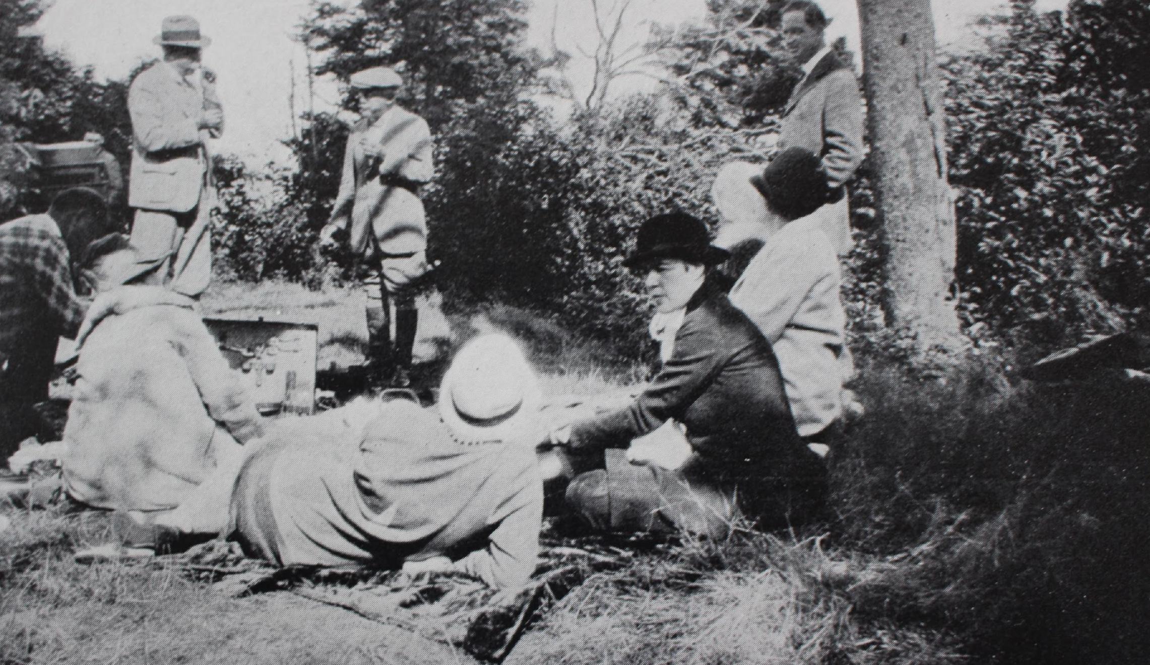
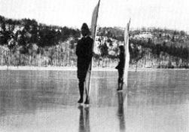
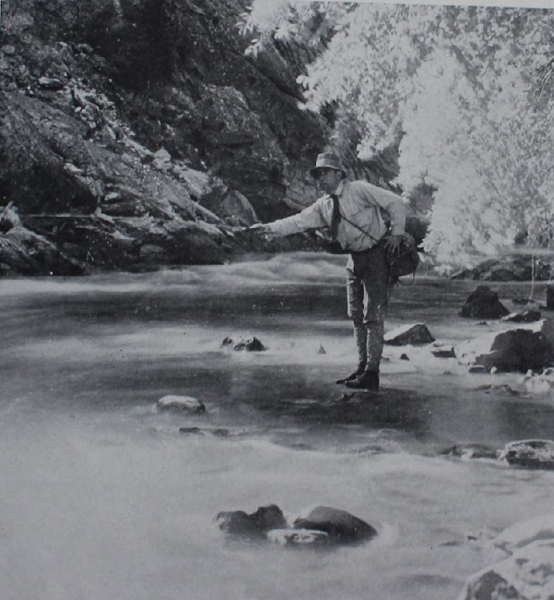
The Lucknow News
Activities at Lucknow
Having a Picnic
Ice Skating
Fishing

Slide 6
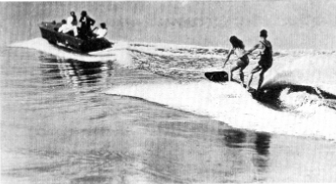
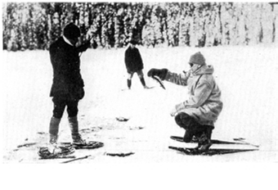
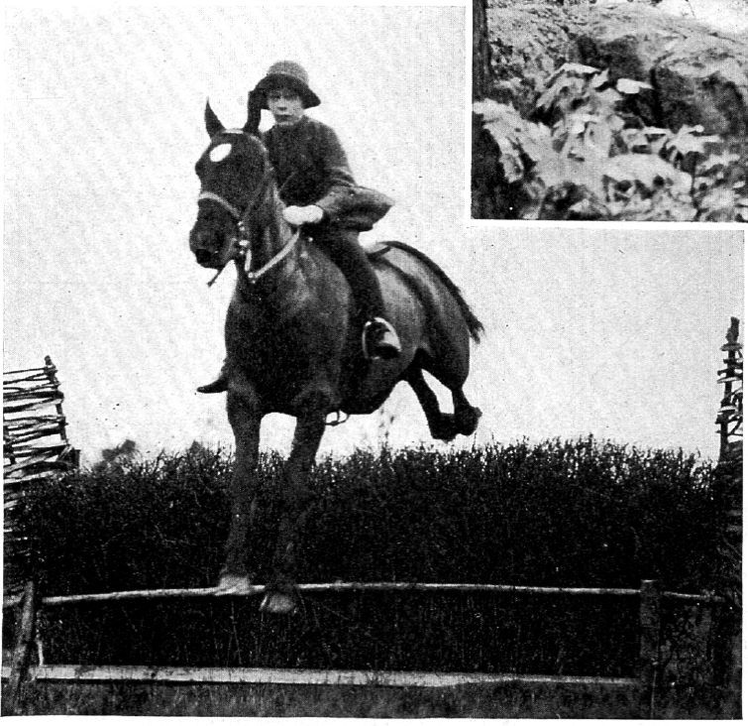
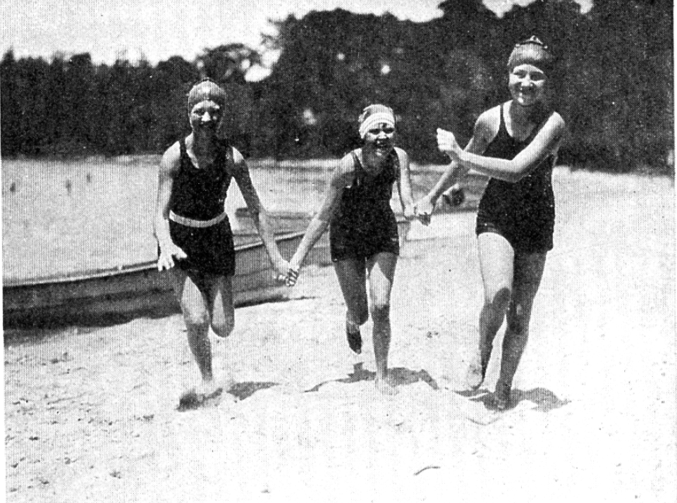
The Lucknow News
Activities at Lucknow
Water Skiing
Snowshoeing
Horse Jumping
Swimming

Slide 7
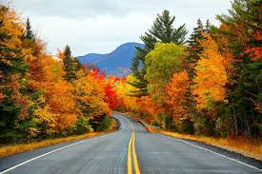

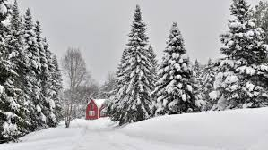

The Lucknow News
Weather in New England
Fall
Spring
Winter
Summer
Notes:
Teacher Notes: Discuss each season in New England and what the weather is like around here. Pause to reflect about what they might need to bring depending on the season they are traveling in (snow boots for winter, bathing suits for summer, etc.).

Slide 8
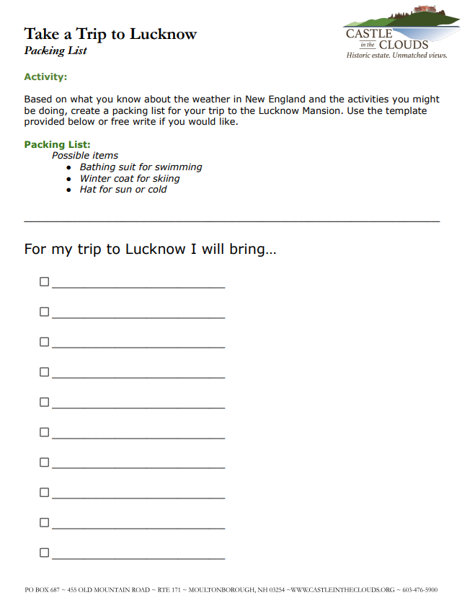
The Lucknow News
Packing List
Based on the activities we discussed and the weather in New England, create a packing list of the items you would like to bring on your visit to Lucknow.

Slide 9
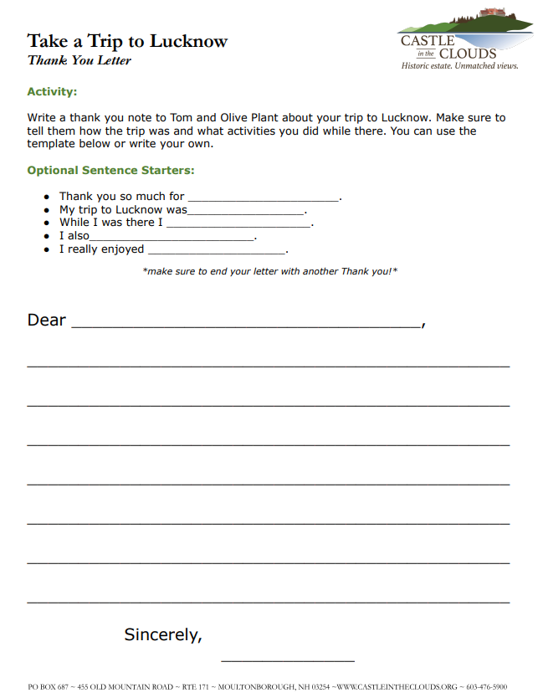
The Lucknow News
Thank You Note
Write a Thank You Note to Tom and Olive Plant for having you at their home. Include as much detail as you can about your trip.
Notes:
Teacher Notes: What’s a Thank You Note? We write thank you notes to thank someone for coming to a party, for a gift, or for having you on a trip/vacation with them. They can be short and sweet or include more details. We address them to the person we are sending them to and then we sign our name when we are finished.

Slide 10
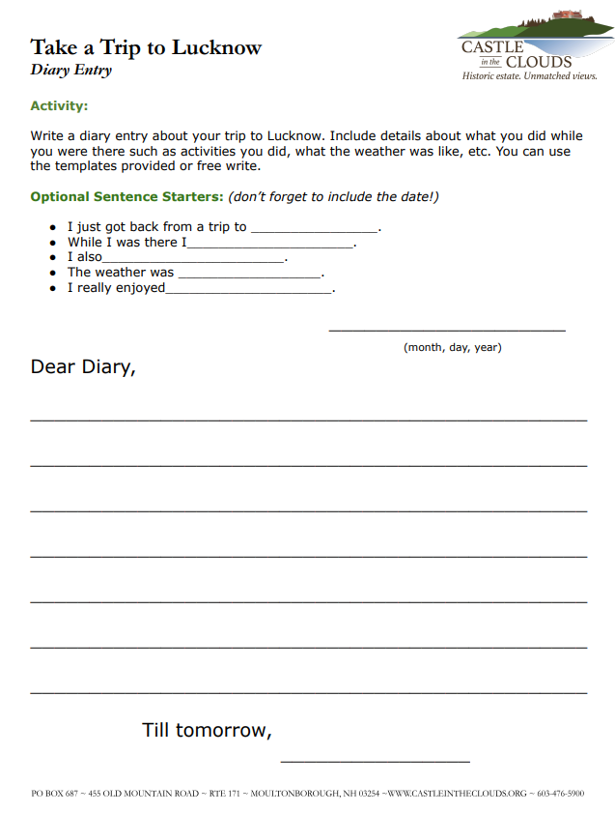
The Lucknow News
Diary Entry
Write a Diary Entry about your trip to Lucknow. Make sure to include what activities you did, how the weather was, and if you have fun!
Notes:
Teacher Notes: What is a Diary? A Diary is like a journal. People write in diaries or journals to remember things they do, places they go, or people they meet. In this case, You might write a diary entry about your trip to Lucknow. Diary/Journal entries always include the date they were written and end with a signature of some kind.

