Slide 1

The Story of Tom and Olive Plant

Slide 2
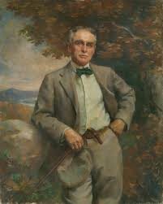
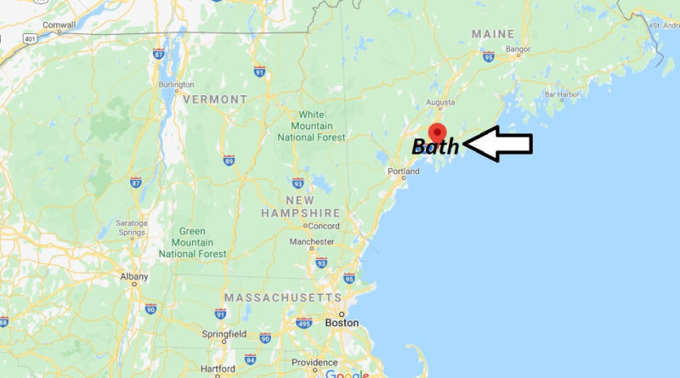
Thomas G. Plant was born in Bath, Maine, in 1859.

Slide 3
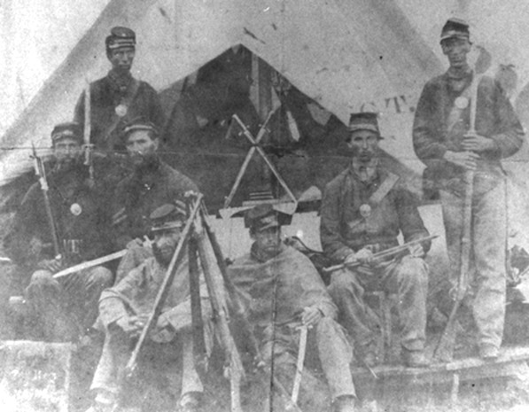
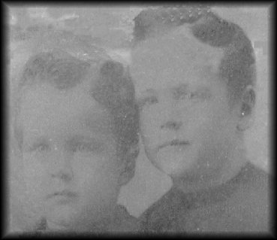
When he was only a few years old, Tom’s father went to fight for the Union Army in the American Civil War. Tom’s father was injured during the war, and had trouble finding work after returning to Maine. Because of this, Tom and his siblings started working as soon as they were old enough.

Slide 4
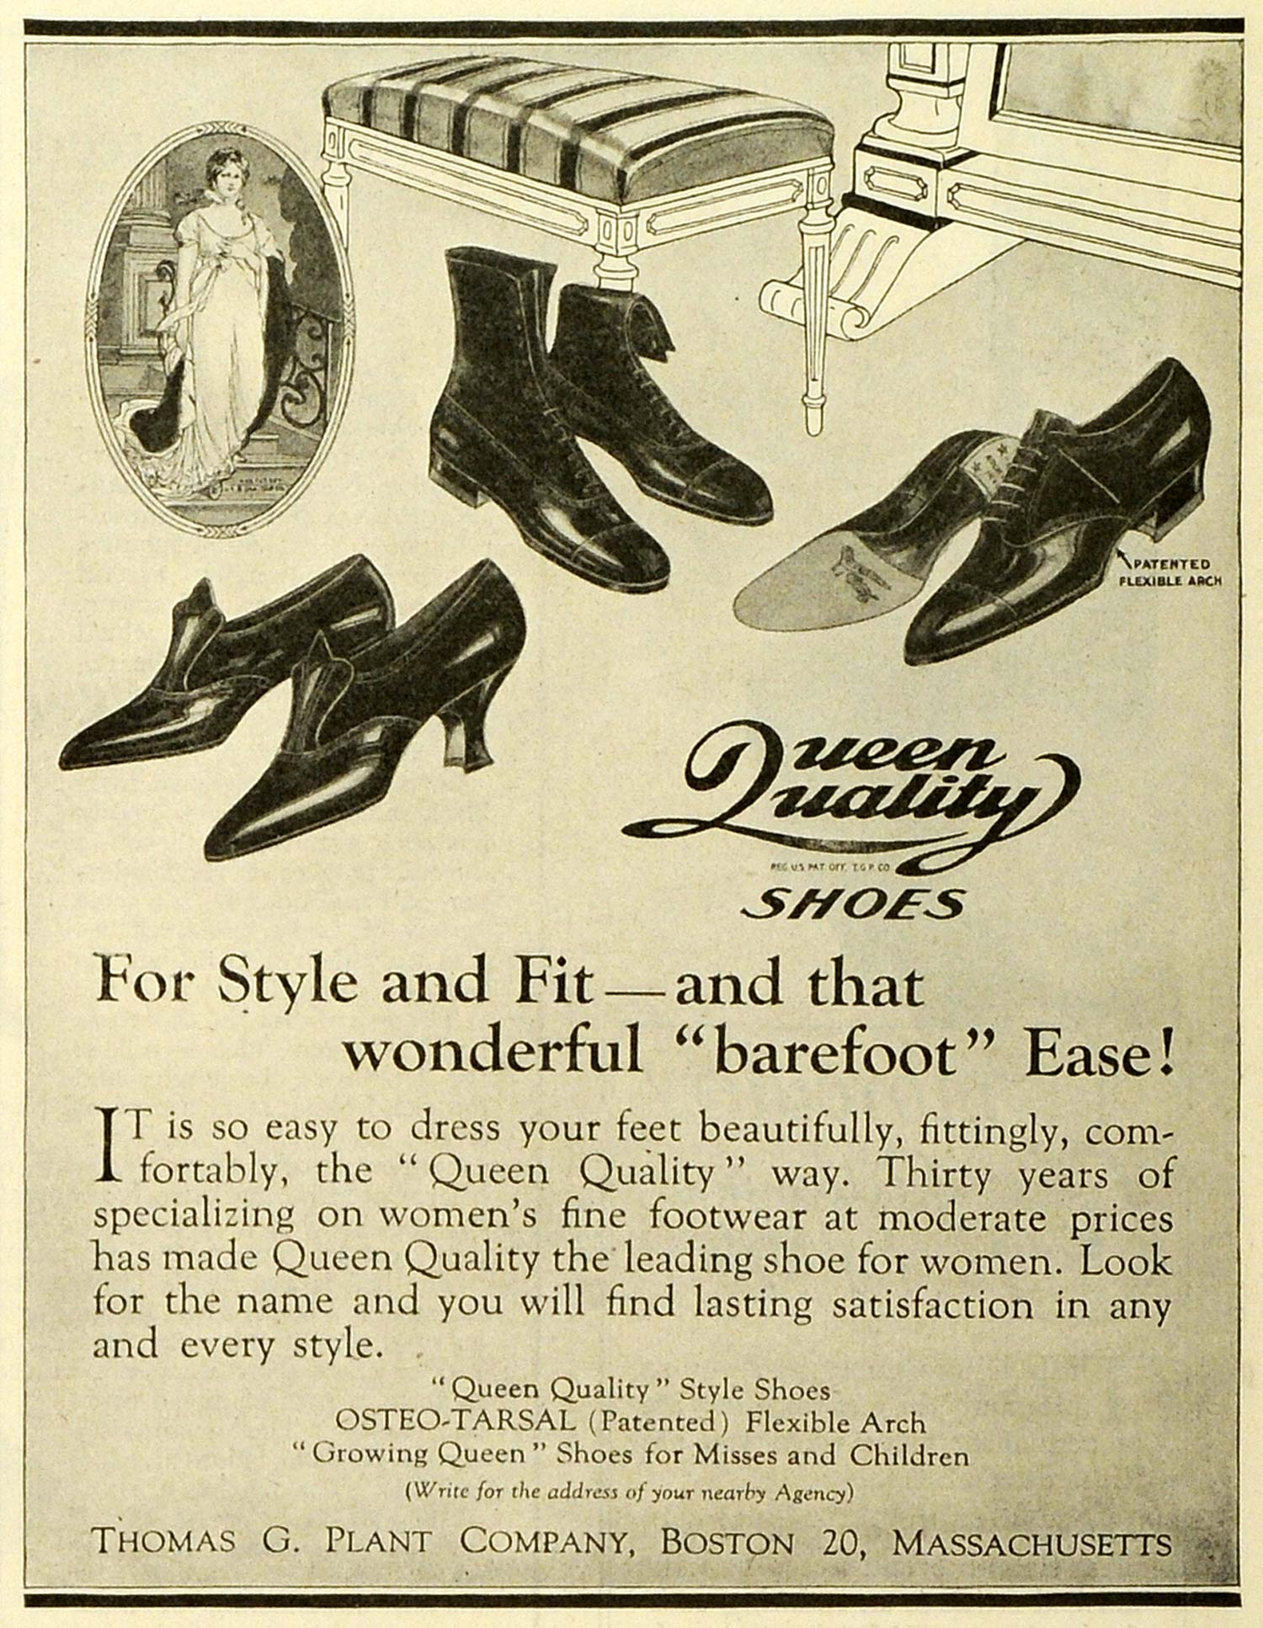
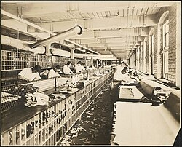
As a teenager, Tom worked in shoe factories in Maine and Massachusetts. He learned everything he could about making and selling ladies’ shoes. He eventually learned enough to open his own factory, and made millions of dollars selling shoes.

Slide 5
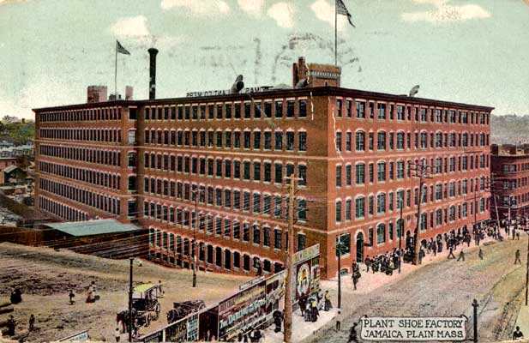
In 1910, Tom sold his shoe company and decided to retire. At that time it was the largest factory in the United States. He traveled to Europe looking for a spot to build a comfortable home.

Slide 6
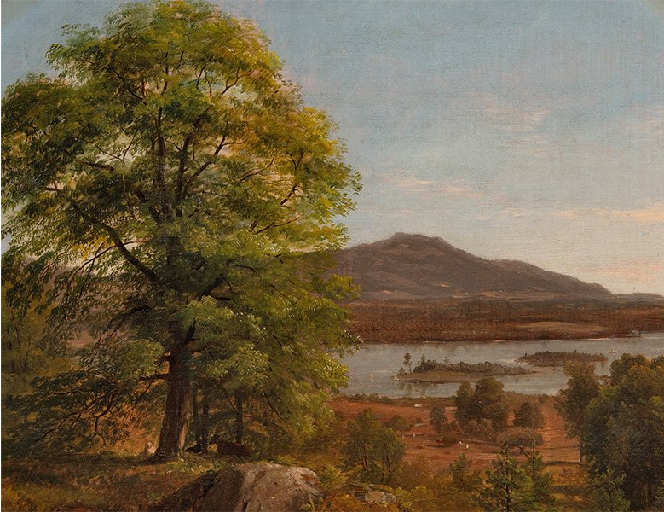
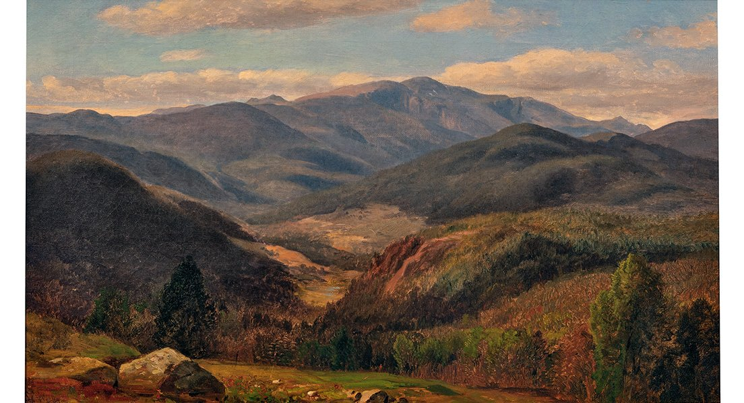
During that trip, Tom’s niece, Amy, told him about the beautiful land of the Ossipee Mountains in Moultonborough, New Hampshire. Without ever seeing it, Tom bought the land and named it Lucknow.

Slide 7
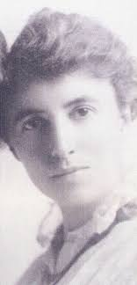
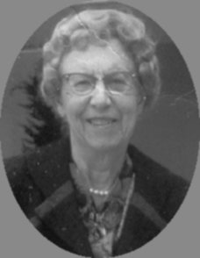
While traveling through Europe, Tom met a woman named Olive Dewey.

Slide 8
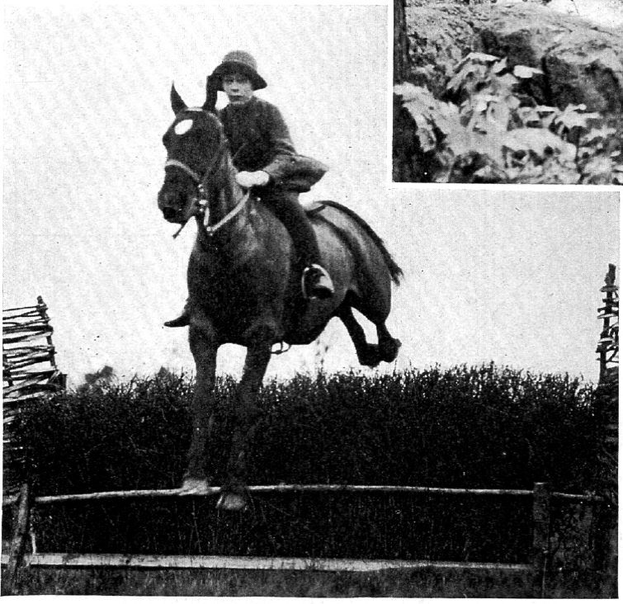
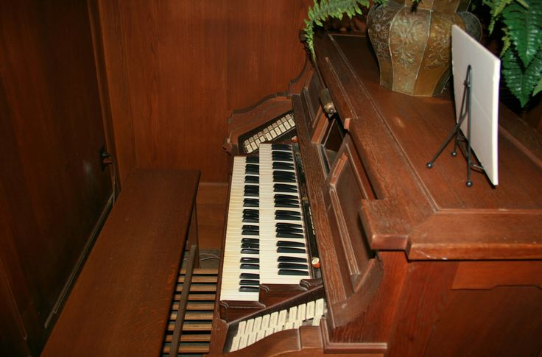
Olive had grown up in Toulon, Illinois. After college, she had worked as a school teacher. Olive was smart and independent. She liked riding horses, doing crossword puzzles, playing cards, playing the organ, and learning different languages. Olive also liked driving her own car, which was not common for women at the time.

Slide 9
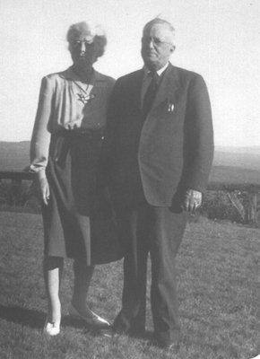
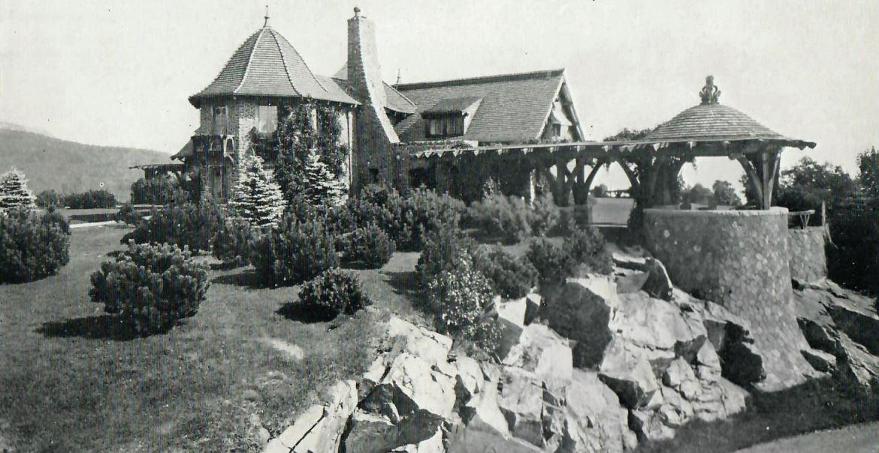
Tom and Olive got married in 1913 and started building a mansion at Lucknow. When the home was finished in 1914, they moved in and lived there for 26 years.

Slide 10
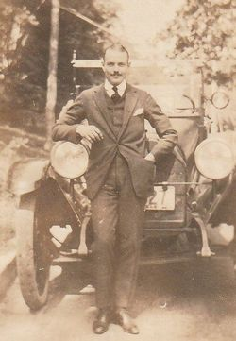
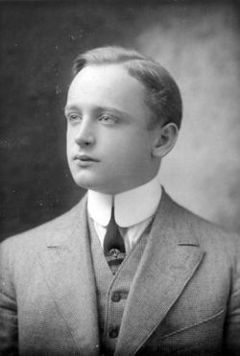
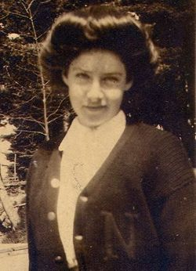
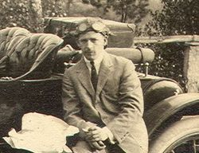
Tom and Olive never had children but they enjoyed spoiling their horses and their nieces and nephews.
Amy Elizabeth Plant
William Franklin Plant Jr.
Thomas Corey Plant
Everett Dunbar Plant Sr.

Slide 11
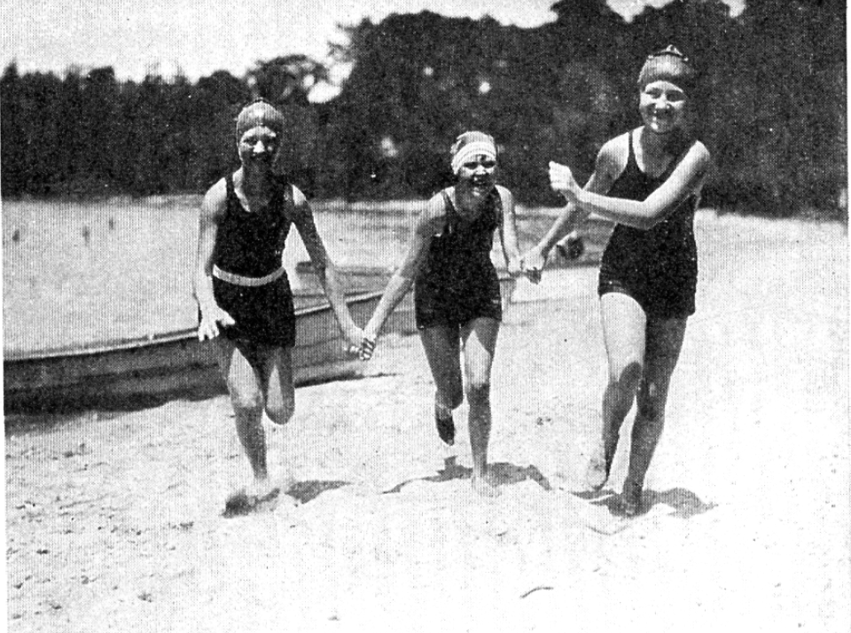
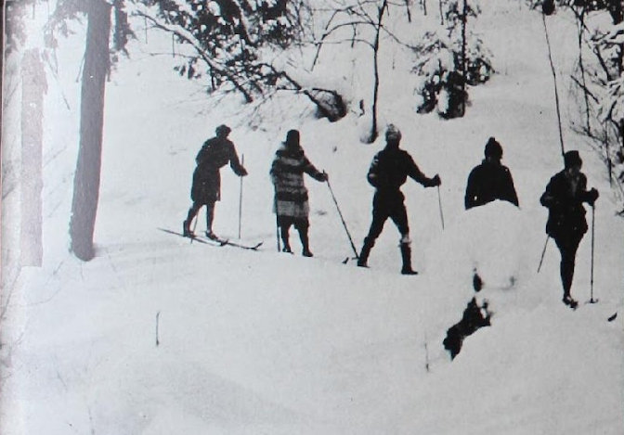
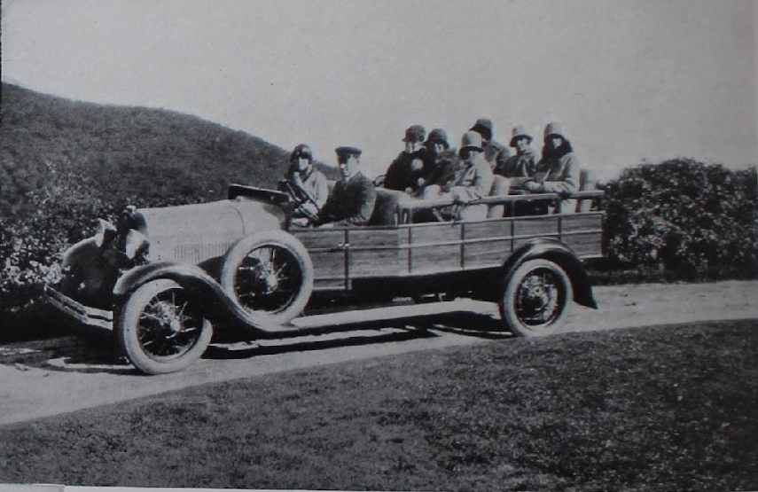
They often invited family and close friends to stay with them at Lucknow, and spent their time outdoors - playing golf and tennis, boating on Lake Winnipesaukee, riding horses, or skiing, snowshoeing, and sledding.

Slide 12
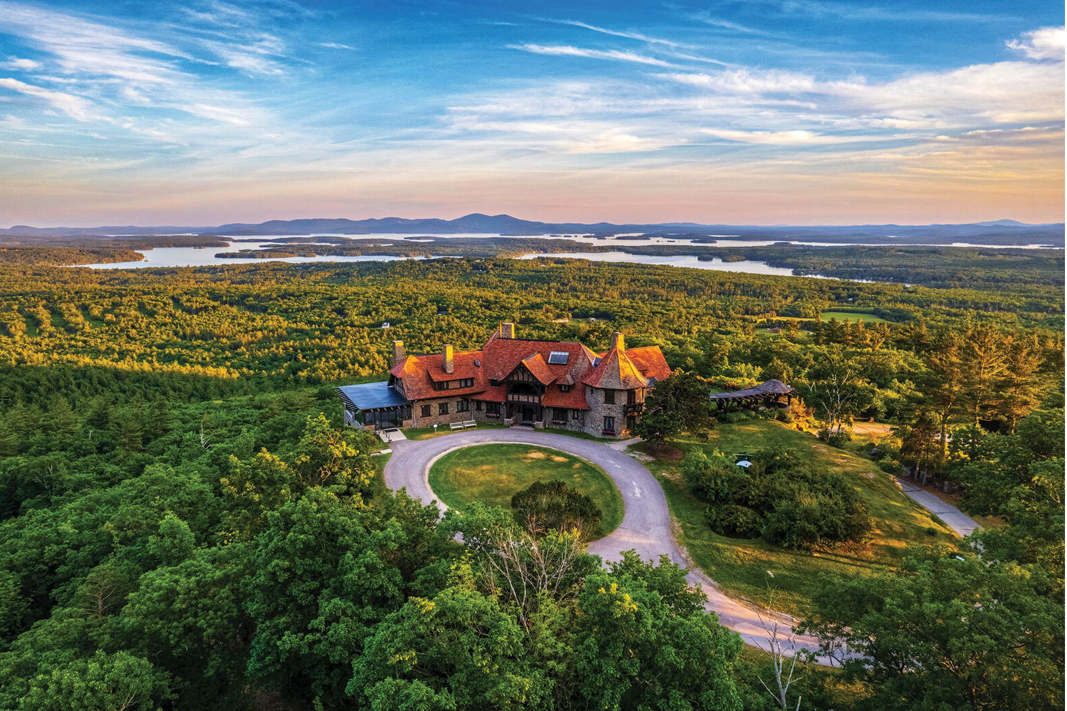
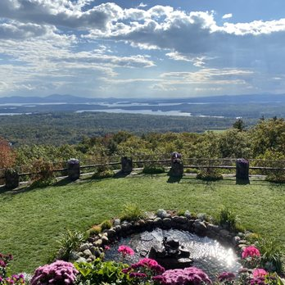
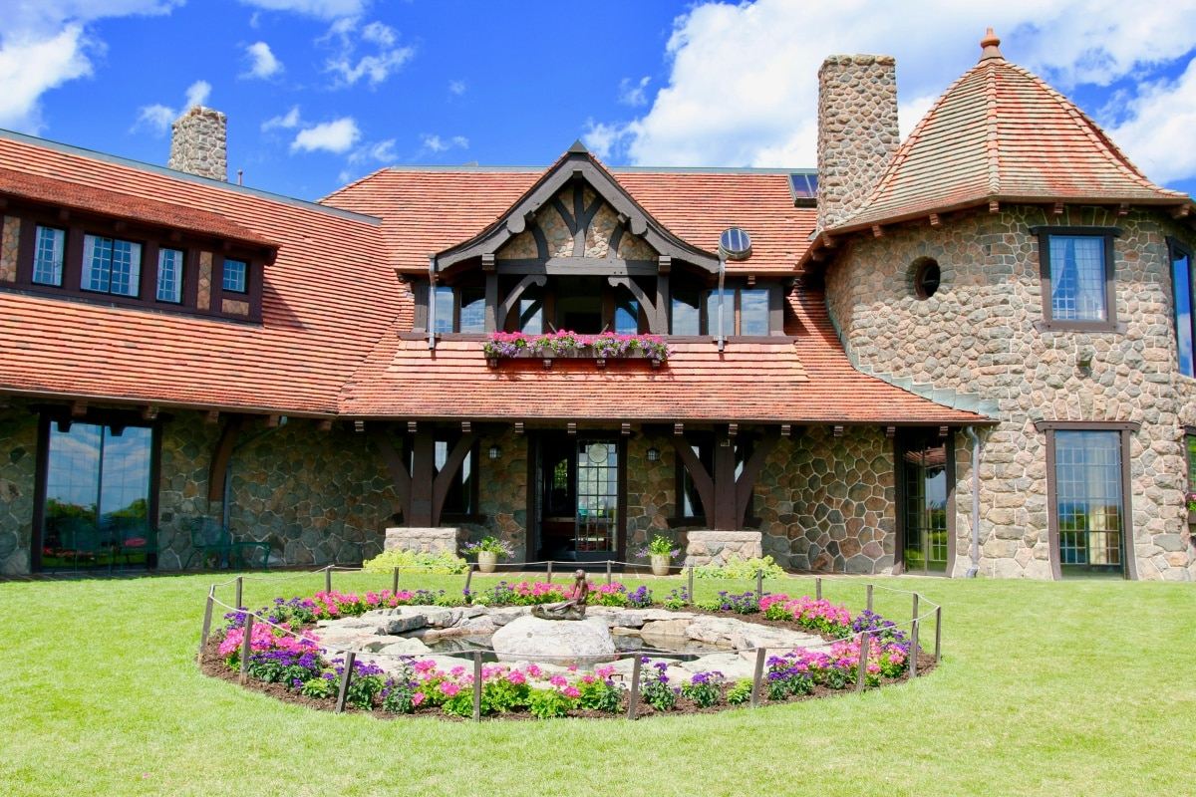
When Tom passed away in 1941, Olive went back to Illinois to be with family. She eventually moved to California to be near her brothers’ families, and lived there the rest of her life. Tom’s will ensured that the Lucknow Estate would always be preserved.

Slide 13
What did you notice about the story (the people, pictures, what was happening, etc.)?
What do you wonder about the story?
What do you want to learn more about during our visit to Castle in the Clouds?
What are some questions we could ask the Museum Interpreters?

