Slide 1

Writing & Mailing
a Postcard

Slide 2
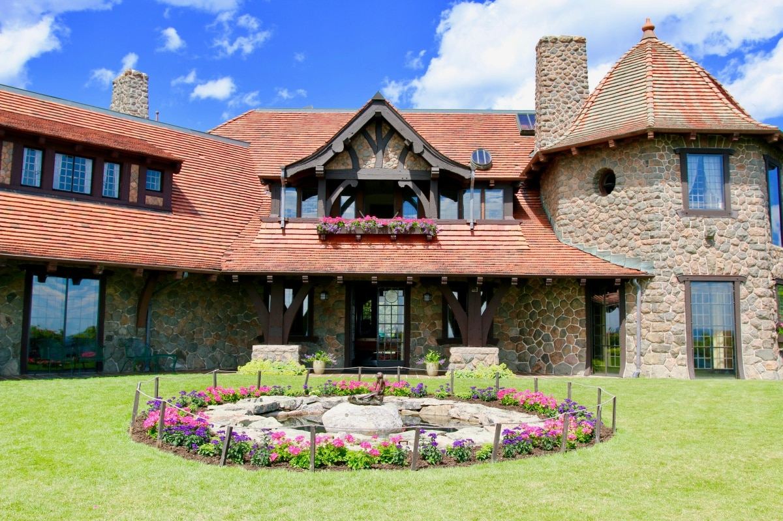
What is a postcard?
A card used for sending a message by mail without an envelope.
Usually there is a picture on one side of it.

Slide 3
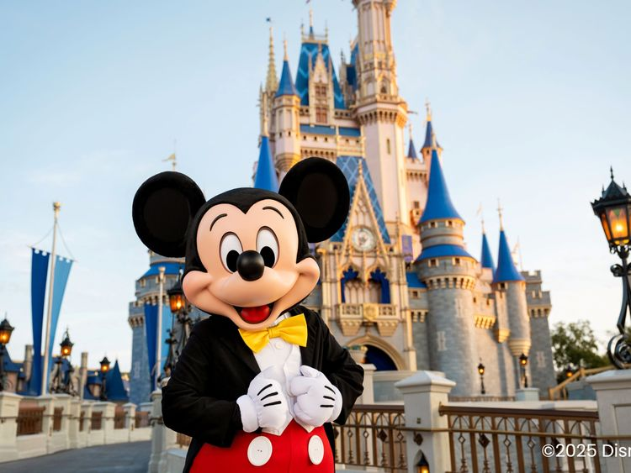
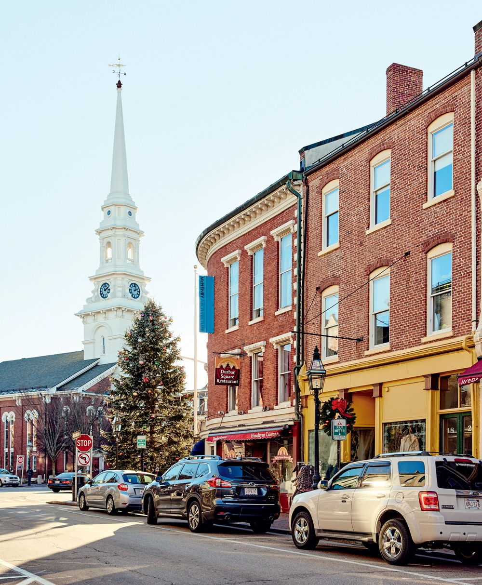
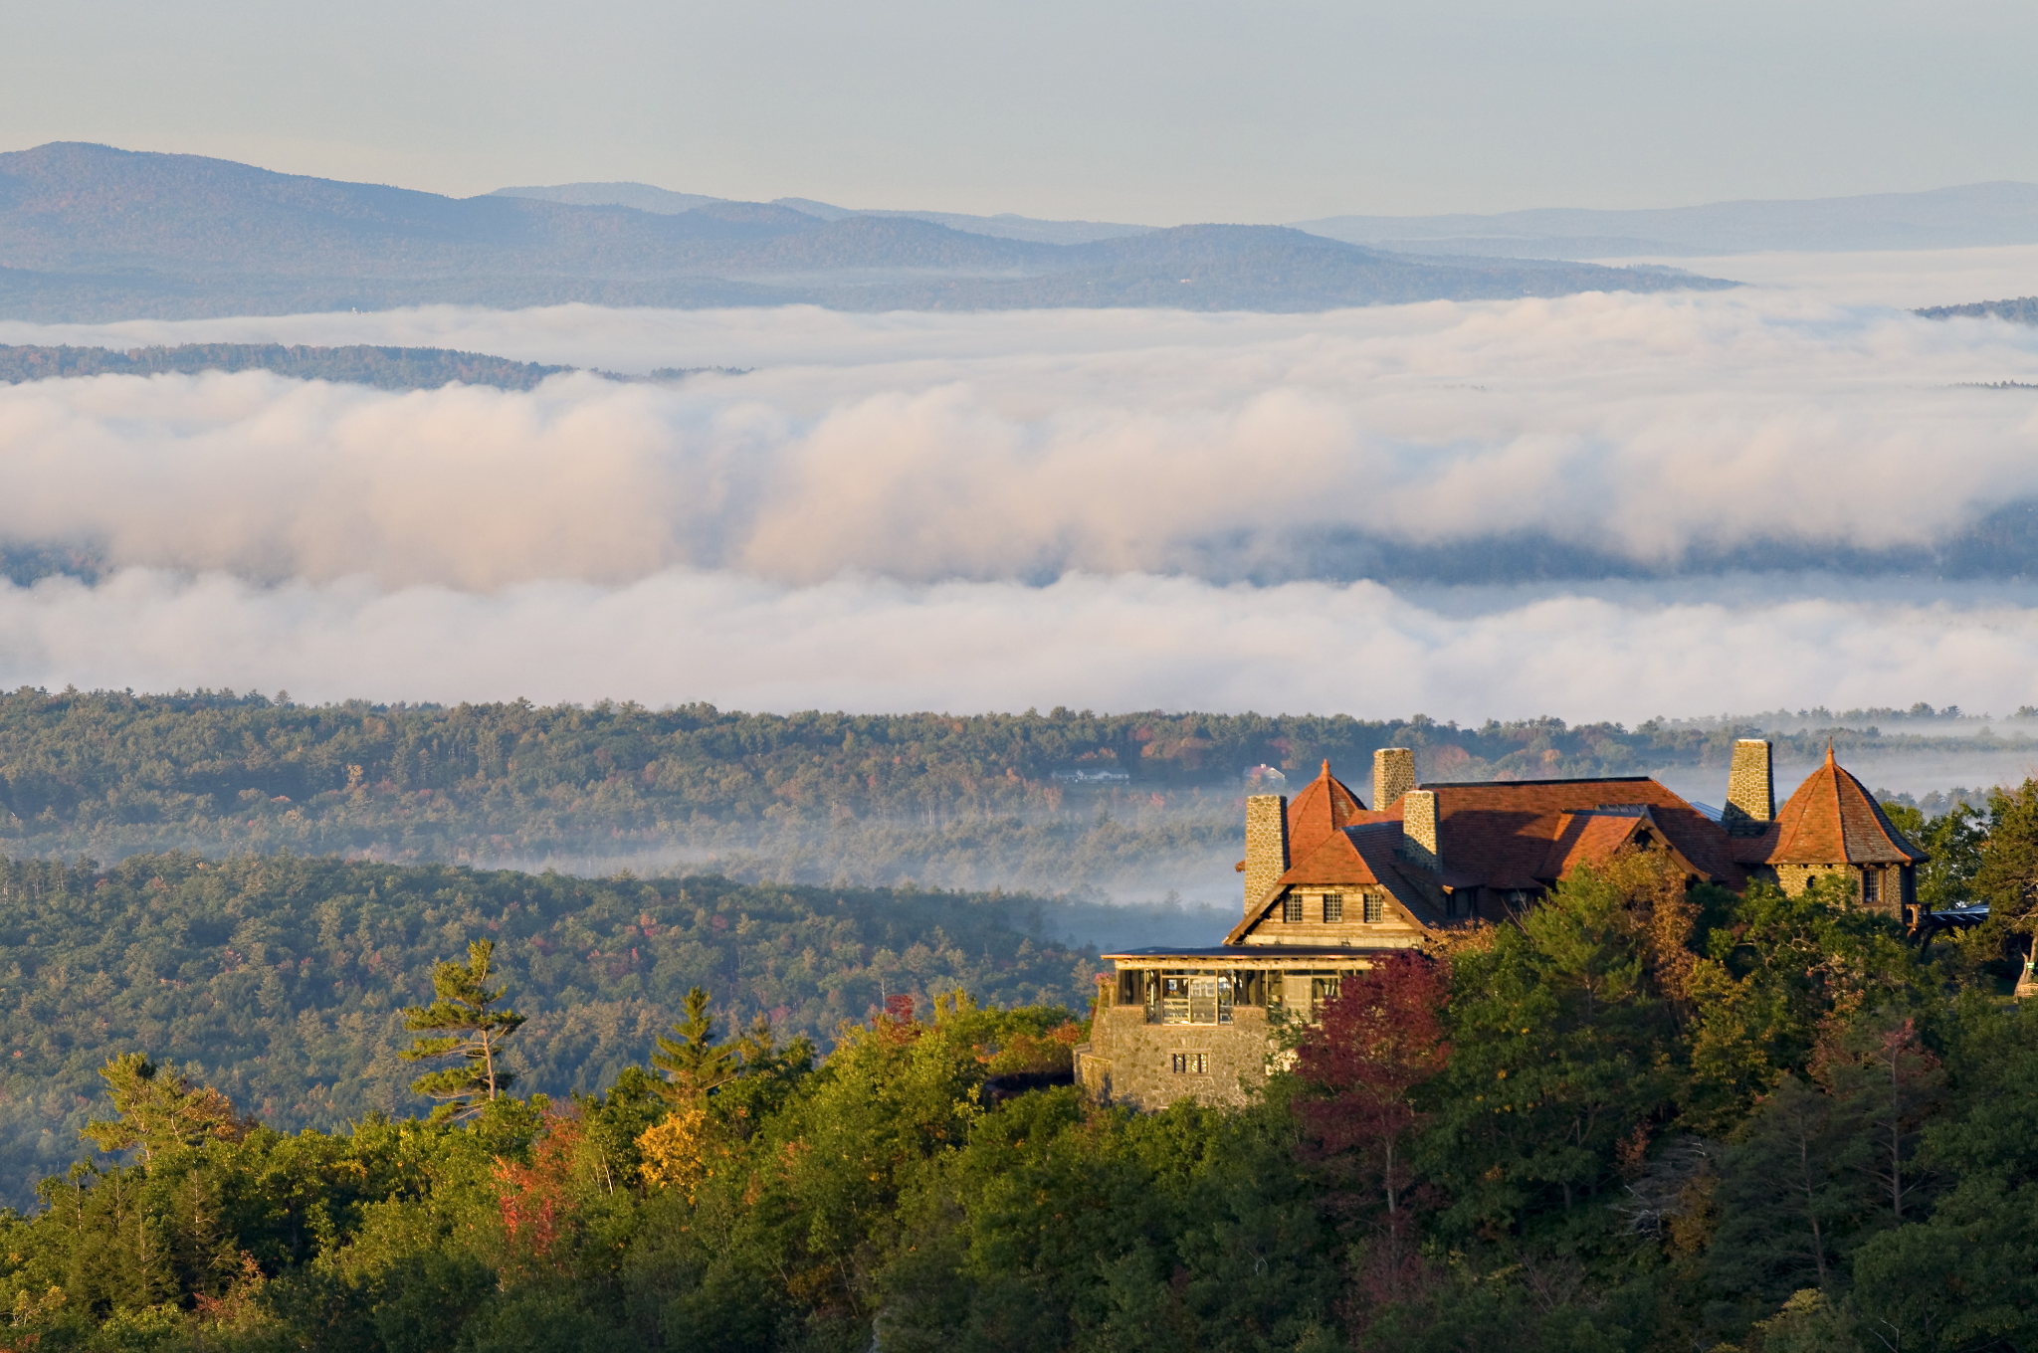
Where might we send a postcard from?
A Vacation Destination
A Field Trip
Towns or Villages
Disney World Orlando, FL
Castle in the Clouds
Portsmouth, NH

Slide 4



Who might we send a postcard to?
Family
Friends
People in the Community

Slide 5


How do we fill out a postcard?
Stamp
Message
Address

Slide 6
What is a stamp and why do we need one?
Stamp
A stamp is like a sticker. It shows that money has been paid to mail a letter or package.
We need them to show that the delivery has been paid for and that the person getting the letter owes no money.

Slide 7
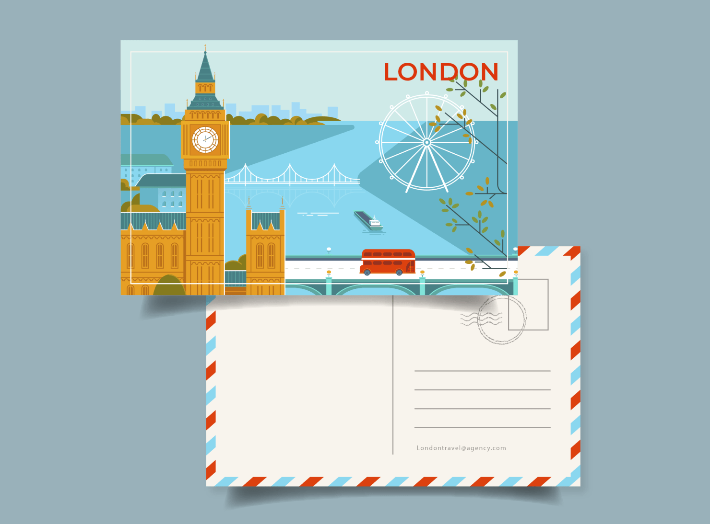
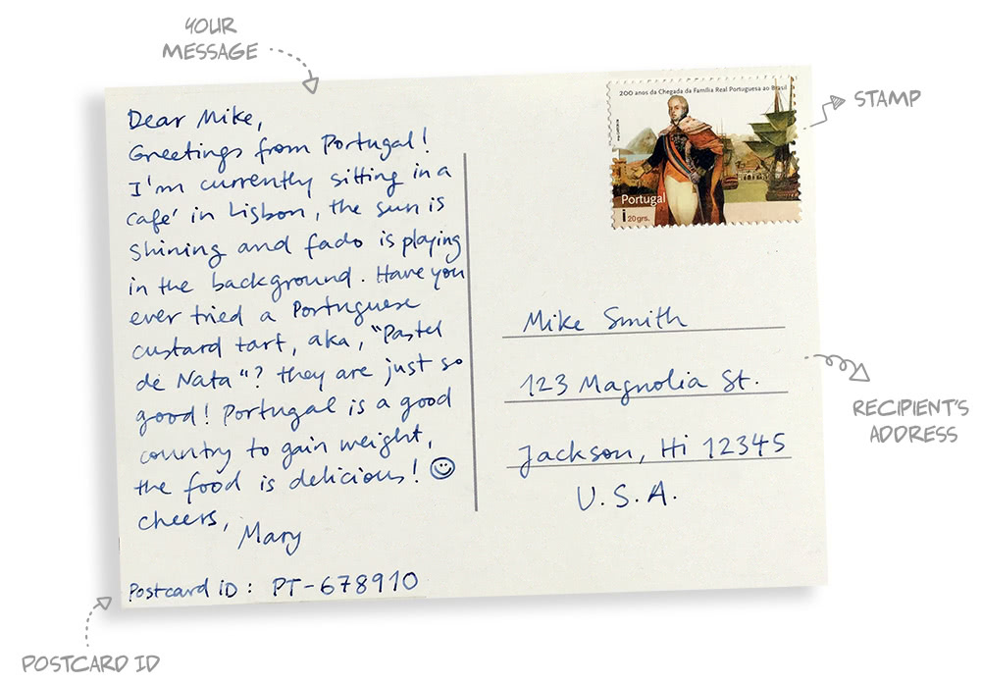
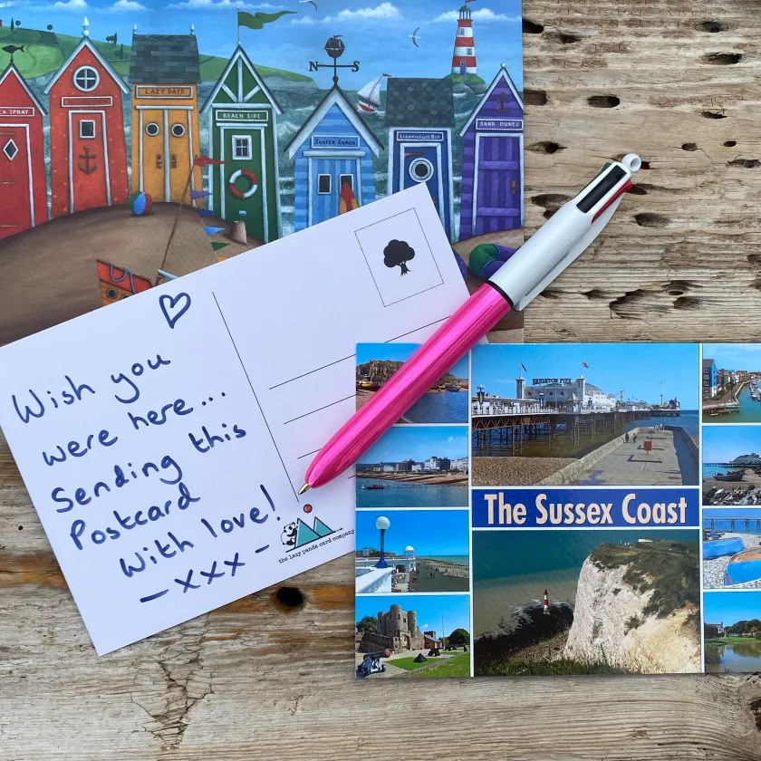
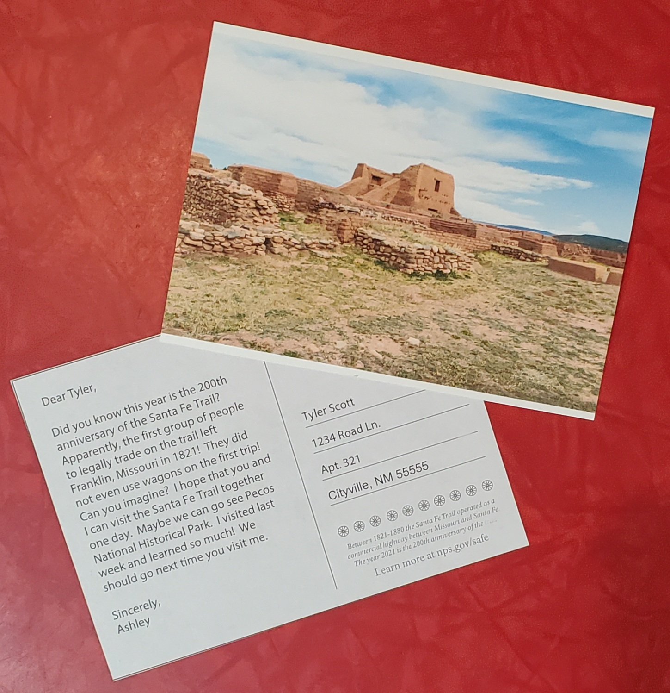
Examples

Slide 8
What could my postcard say?
Dear Nana,
On Tuesday, my class went to Castle in the Clouds for a field trip. My favorite part was the Lucknow Mansion. I also enjoyed our hike to Pine Lodge. It was so much fun.
Sincerely,
Sarah
Pauline Simmons
35 Yahtzee Dr.
Fitchburg, GA 09808

Slide 9
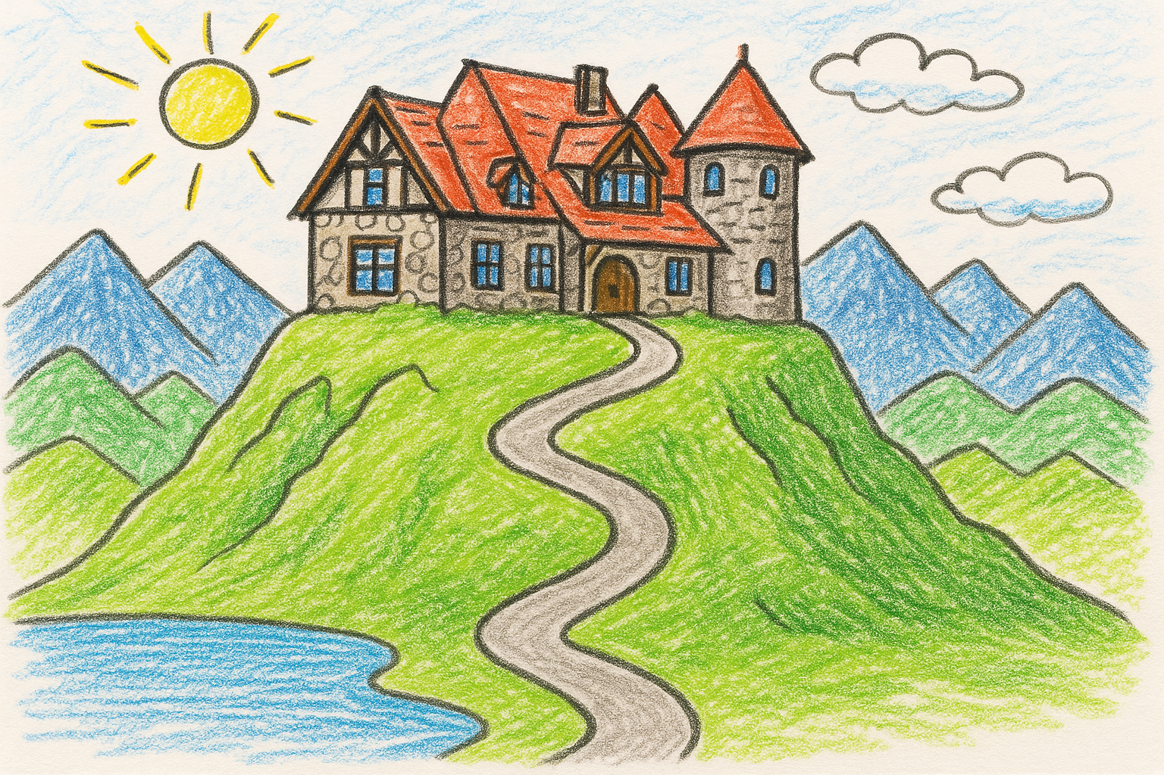
What could my postcard look like?

Slide 10
Want to send it to Castle in the Clouds?
If you would like to send it to Castle in the Clouds you can start your message with…
Dear Castle in the Clouds,
When finished, use this address
Castle in the Clouds
Education Department
PO Box 687
Moultonborough, NH 03254

Slide 11
Questions?

